Slide 1



Slide 2

Family planning is essential
Family planning programs are
high-impact, cost-effective interventions
that allow individuals to fulfill
their reproductive intentions and
improve maternal, neonatal, and
child health outcomes.

Slide 3

Family planning
is especially
important for youth
Family planning offers additional benefits to young women, including:
Protecting access to education
and employment.
Reducing the health risks of
early childbearing.

Slide 4





Youth contraceptive practice differs from that of older women
Youth (ages 15 to 24) have higher rates of discontinuation than older women.
Youth are also more likely to:
Become pregnant while
using contraceptives.
Be offered and use short-acting
user-controlled methods, such as
the pill, injectable, or condom.
Source family planning from private and informal sources, such as pharmacies and drug shops.

Slide 5

Why do youth stop using contraceptives?

Slide 6


Changing
reproductive needs
Unmarried youth are more likely to discontinue family planning due to irregular sexual activity.

Slide 7

Changing
reproductive needs
Married youth may discontinue because they want to become pregnant immediately or early
in their marriage.

Slide 8
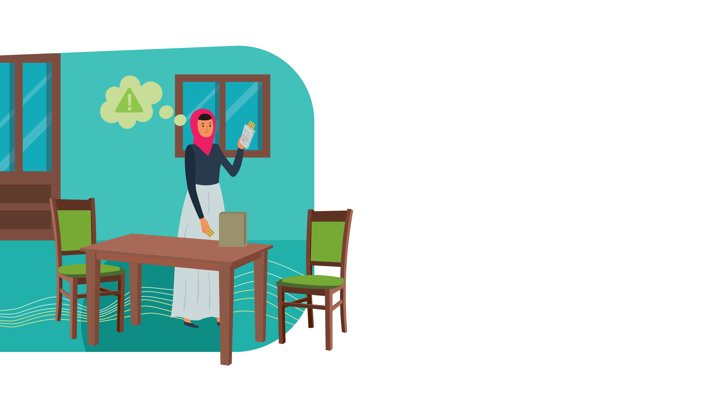
Method-related factors
Side effects (for example, menstrual bleeding changes and weight gain) and health-related concerns (for example, fear of infertility and birth defects) are
the main reasons for contraceptive discontinuation across age groups.
Youth may be particularly sensitive to side effects.

Slide 9

Poor quality of care
Poor quality of care contributes to high rates of contraceptive discontinuation across age groups.
Youth face significant barriers to accessing quality family planning care, including provider bias.

Slide 10
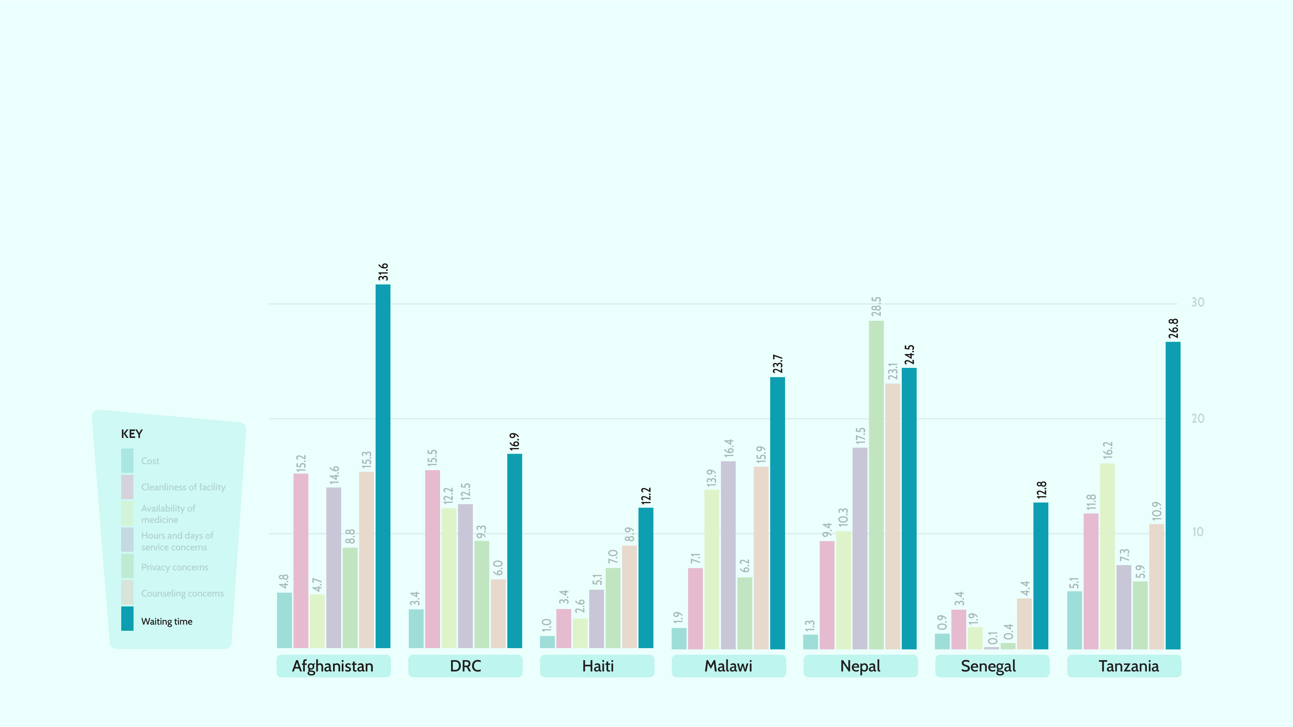
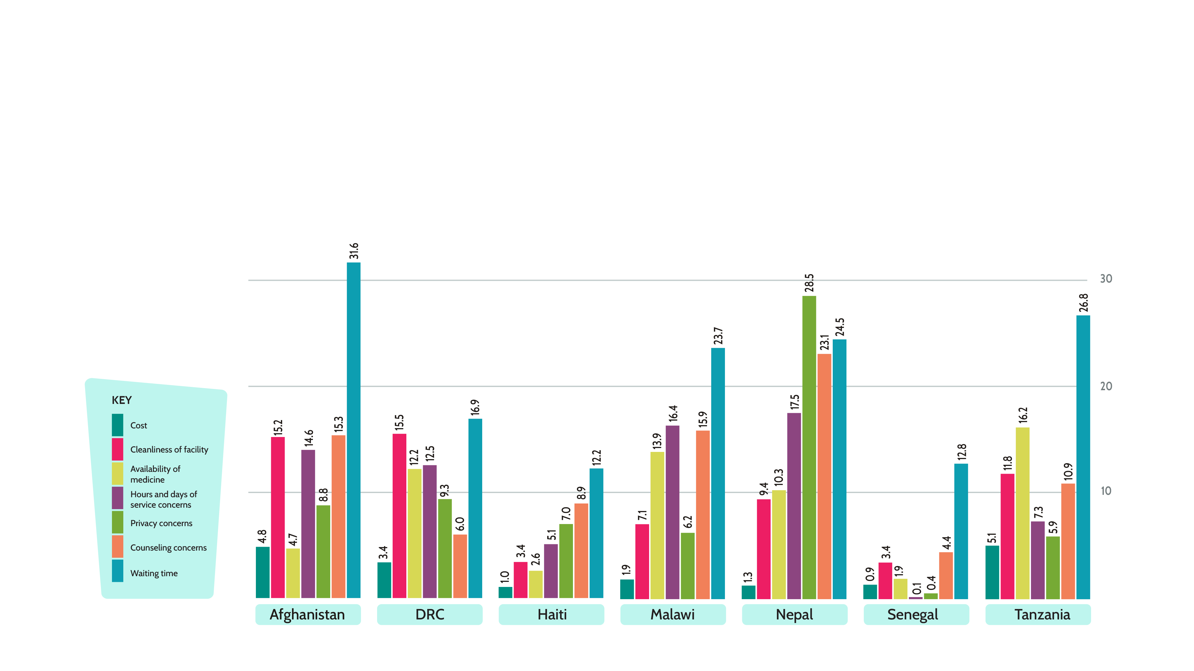
Youth report concerns with waiting time and other factors when seeking family planning care

Slide 11



Barriers to contraceptive continuation among youth
SCENARIO 1
A young woman arrives at a health facility to seek family planning services.
Her provider recommends the injectable because she is young and because other methods are out of stock.
After her appointment, the provider/health facility does not contact her.
She must wait a long time to see a provider. She is worried that friends, neighbors, or family members will see her in the waiting room.
The provider does not inform her about side effects or dispel common myths associated with the injectable.
She experiences bleeding changes and is concerned about the impact on her future fertility. She is not motivated to return to the health facility and ends up discontinuing.

Slide 12



Barriers to contraceptive continuation among youth
SCENARIO 2
Because pharmacy and drug store staff are not trained to provide counseling, she does not receive any counseling or information.
A young woman arrives at a pharmacy.
With her limited resources, she purchases the pill.
After taking the pill, she experiences side effects, including weight gain. This displeases her. Even though she does not wish to become pregnant, she discontinues the pill.

Slide 13

Strategies to enhance contraceptive continuation
The following strategies are associated with increased contraceptive continuation:
Providing high-quality
contraceptive counseling.
Actively following up with clients between appointments.
Ensuring access to the full range
of contraceptive methods.

Slide 14

How can policymakers address obstacles to contraceptive continuation among young people?

Slide 15


Elevate attention and resources to support existing family planning users.
National and subnational strategies and policies should include program goals and monitoring systems that focus on current family planning users.

Slide 16


Ensure policies support youth access to the full range of family planning methods regardless of age, marital status, and number of children, and without requiring the consent of
a third party.

Slide 17


Provide client-centered care in recognition of youth’s diverse reproductive needs.
Like all family planning users, youth’s needs vary based on marital status, geography,
and other factors. Family planning programs must respond to the varying needs of different groups of youth and not consider them as a homogeneous group.

Slide 18


Ensure provider guidelines promote high-quality, supportive contraceptive counseling to youth, including:
A case history that includes prior contraceptive use and current contraceptive needs.
Advice on managing side effects.
Easy-to-understand information that dispels myths and misconceptions about contraceptive methods.

Slide 19


Ensure youth can access contraceptives in the private and informal sector.
Pharmacy and drug shop staff should receive training and support on the family planning methods they offer.

Slide 20
Ensure youth can access contraceptives in the private and informal sector.
Out-of-pocket costs for youth,
who earn less money, should be addressed through the provision of vouchers that youth can exchange for family planning care.

Slide 21


Ensure providers have the tools and platforms to use a range of follow-up mechanisms between appointments.
Actively following up with women who are using a method increases contraceptive continuation and facilitates switching in the case of unacceptable side effects.

Slide 22
Ensure providers have the tools and platforms to use a range of follow-up mechanisms between appointments.
Countries should implement a variety of follow-up mechanisms, including phone calls, SMS or automated text messages/bots, home-based visits by a health care worker, and a hotline.

Slide 23


Ensure that health care delivery points maintain the full complement of methods and advance distribution of self-administered methods.
Broadening the method mix available at service delivery points and through an effective referral mechanism ensures that youth can access their preferred method and switch to another method immediately if they experience unacceptable side effects.

Slide 24

Thank you!
This presentation is based on a policy brief developed
by the PACE project. For additional information,
please contact Cathryn Streifel at: cstreifel@prb.org.

Slide 25
REFERENCES
Kaitlyn Patierno, Choices and Challenges: Dynamics of Contraceptive Use (Washington, DC: Population Reference Bureau (PRB) 2019).
Ann K. Blanc et al., “Patterns and Trends in Adolescents’ Contraceptive Use and Discontinuation in Developing Countries and Comparisons With Adult Women,” International Perspectives on Sexual and Reproductive Health 35, no. 2 (2009): 63-71.
Venkatraman Chandra-Mouli, et al., “A Never-Before Opportunity to Strengthen Investment and Action on Adolescent Contraception, and What We Must Do to Make Full Use of It,” Reproductive Health 14, no. 85 (2017). DOI: 10.1186/s12978-017-0347-9.
Sarah Castle and Ian Askew, Contraceptive Discontinuation: Reasons, Challenges, and Solutions (Washington, DC: Population Council and FP2020, 2015).
John Ross, Jill Keesbury, and Karen Hardee, “Trends in the Contraceptive Method Mix in Low- and Middle-Income Countries: Analysis Using a New ‘Average Deviation’ Measure,” Global Health: Science and Practice 3, no. 1 (2015): 34-55.
Sarah E.K. Bradley, Hilary M. Schwandt, and S. Khan, Levels, Trends and Reasons for Contraceptive Discontinuation, Demographic and Health Survey (DHS) Analytical Studies, no. 20 (Calverton, MD: ICF Macro, 2009).
Michelle Weinberger and Sean Callahan, The Private Sector: Key to Reaching Young People With Contraception (Bethesda, MD: Abt Associates, 2017).
Jacqueline E., Darroch, Gilda Sedgh, and Haley Ball, Contraceptive Technologies: Responding to Women’s Needs (New York: Guttmacher Institute, 2011).
Saverio Bellizzi et al., “Adolescent Women With Unintended Pregnancy in Low- and Middle-Income Countries: Reasons for Discontinuation of Contraception,” Journal of Pediatric and Adolescent Gynecology 33, no. 2 (2019): 144-48. DOI: 10.1016/j. jpag.2019.11.004.
Kate H. Rademacher et al., “Menstrual Bleeding Changes Are NORMAL: Proposed Counseling Tool to Address Common Reasons for Non-Use and Discontinuation of Contraception,” Global Health Science Practice 6, no. 3 (2018): 603-10. DOI: 10.9745/ GHSP-D-18-00093.
Ann K. Blanc, Siân L. Curtis, and Trevor N. Croft, “Monitoring Contraceptive Continuation: Links to Fertility Outcomes and Quality of Care,” Studies in Family Planning 33, no. 2 (2002): 127-40.
Emma Radovich et al., “Who Meets the Contraceptive Needs of Young Women in Sub-Saharan Africa?” Journal of Adolescent Health 62, no.3 (2018): 273-80. DOI:10.1016/j. jadohealth.2017.09.013.

