Slide 1
A Multimedia Advocacy Training Toolkit for Young People Fighting for Change
!
We Will Be Heard
Notes:
Do you have some ideas for making positive change in your community and maybe even the world, but you are having trouble getting anyone to listen to you? Young changemakers often struggle to make themselves heard by adults in power, who may be too busy with or distracted by their own priorities to take time to hear youth perspectives.
Well, we are going to learn how to communicate in a way that we will be heard by community leaders, power-holders, and policymakers.This session begins our journey through this multimedia advocacy training toolkit, produced by PRB and the PACE project. This toolkit includes three modules and 11 units of training materials, beginning with foundational concepts of leadership and advocacy, moving on to effective communication skills, and ending with some practical sessions that will guide us through creating our own multimedia advocacy campaign. I am very happy to have you along for this journey and I hope you will feel that these sessions provide you with the knowledge and skills to help you frame your message in a way that your voice is heard.

Slide 2
Foundations of
MODULE 1
Advocacy
&
Leadership
Notes:
Welcome to Module 1! There are three units In this module that will go over some foundational concepts of advocacy, leadership, and policy creation and change.

Slide 3
Youth
Unit 1.1
Leading
Change
1
IMAGE: SHUTTERSTOCK
Notes:
Our very first session is called “Youth Leading Change.” Because you are here today, I am going to assume that you believe that youth can and should be involved in creating a better world. We are excited to learn together, and to hopefully build skills that will make us more effective leaders and changemakers.
You may not realize how much positive change around the world would not have been possible were it not for the involvement of young people.
Here are a few examples of both recent and historical policy changes in which youth played a critical role:
Adolescent Sexual and Reproductive Health Policy, 2015, Kenya—Promoted adolescents’ access to sexual health services, such as testing and care for sexually transmitted infections. This change improved on a previous policy that only covered reproductive health for adolescents, and also added specific provisions for vulnerable populations.
Civil Rights Act of 1964, United States—Outlawed discrimination based on race, color, religion, sex, or national origin.
Marriage, Divorce, and Family Relations Act, 2015, Malawi—Set 18 as the minimum age for marriage.
End of Apartheid, 1994, South Africa—Ended the system of institutionalized racial segregation and repression in South Africa that had been in place since the 1940s.
[Ask:] What are some other policy changes that you know of that youth leaders have helped to make a reality? [Generate responses.]
Youth leaders can be involved in all kinds of work to drive social change. In this session and for the rest of the training, we will be focusing on youth leaders who are working to influence policy through communication, negotiations, and collective action.

Slide 4
What Is a Leader?
2
IMAGE: UNSPLASH
Notes:
In this session, we’re talking about leadership and how to be an effective leader. First, let’s define what leadership means.
[Ask:] Are there certain qualities that make someone a leader, even if they aren’t in a position of leading a group, project, or institution? [Generate responses.]

Slide 5
How Do Young People Lead?
3
PHOTO BY SANG TAN FOR NTB SCANPIX
Notes:
[Ask:] What does it take to be a leader? Can young people lead? [Generate responses.]
Of course, if you’ve chosen to go through this training, you understand that young people can be excellent leaders! Unfortunately, due to bias, young people sometimes need to work even harder than older people to be respected as professionals.
[Generate discussion about challenges they have had as youth advocates and/or participants’ experiences having their inputs dismissed or not taken seriously by asking questions like:
Have you ever faced a situation when you felt like you were being held to a higher standard than you would if you were older?
Have you been told that your ideas are idealistic or impractical?
What do you think are some reasons why young people aren’t taken seriously?]
In many countries, young people’s ideas aren’t valued as much as those of older people. Sometimes youth inputs are dismissed as being naïve or impractical. Other times, decisionmakers may resist change and so may push down new ideas that come from youth out of a desire to maintain the status quo. In some places, cultural norms that equate age with wisdom reinforce these challenges facing youth advocates.

Slide 6
Leadership Qualities
4
Persuasive
Professional
Reliable
Responsible
Others?
Notes:
People of all ages can be leaders if they demonstrate qualities of leadership. Here are a few character traits you might think of when you think of a leader.
[Ask:] Are there others? [Generate responses.]
This session will give you tips and tools to increase your effectiveness so that you can create the change you want to see in your community and maximize your professional growth. Many of the strategies and resources that will be shared in this session apply to any professional person engaging in evidence-based advocacy–young or old. When you work hard to be an effective leader, you can more easily convince others to join your cause and work with you, and it’s easier to be taken seriously.
None of us are born with these qualities, they are learned! Let’s consider what actions youth leaders might take to show the world that they are effective.

Slide 7
Do the
Work!
What types of actions do you expect from a leader? For each quality of a leader listed on the worksheet, write down some actions that you think a person can take to be perceived as having that quality.
5
IMAGE: UNSPLASH
Notes:
Now, we’re going to do an exercise to get us thinking about what it means to be a leader.
[Read slide. Distribute the Exercise 1.1A Worksheet to participants. This exercise can be completed as individuals or in small groups, so choose what works best for your group. Allow 5-10 minutes for participants to complete the worksheets, then invite participants to share some of their answers with the entire group for an additional 5-10 minutes, depending on time available and engagement level.]

Slide 8
Take time to think carefully about what motivates you personally
Defining Your Own Priorities
Develop your leadership agenda
6
Talk to other youth about their motivations and priorities
Notes:
As you develop your skills as a youth leader, make sure to take the time to define your own priorities. What motivates you? How have your life experiences brought you to where you are today? What are your hopes for other youth?
Every youth leader decides to get involved in a cause for a reason. What are your priorities? Name them out loud and keep those priorities at the center of all you do.
[Optional: Engage participants in an open discussion about what inspired them to get involved in their area of interest.]
When approaching a new leadership opportunity, it’s important to think through how it relates to your professional and personal priorities. Brainstorm in advance what your message is, what your motivations are, and what you hope to achieve.
Sometimes youth leaders are pulled in a lot of different directions and can be told what to say rather than asked what they think. As a youth leader, you have a right to not take part in activities when participation is tokenistic—for example, you're invited to speak because you're the only young person in the room—rather than inclusive and meaningful.
If you develop your own leadership agenda, then you will be less likely to be swept up in the agendas of others—which may not help you reach your goals.
Finally, always take the time to engage with other youth about their motivations and priorities. As a youth leader, you have a lot to learn from and share with your peers.

Slide 9
Building Your Network
Seek out other youth who are also working in your area of interest
Find a mentor—and offer your skills to mentor others
7
Learn from those more experienced than you (as well as those with less experience)
Notes:
To be an effective youth leader, it is vital that you build your professional network. In your area of interest, you are likely connected to a broad group of people with whom you regularly exchange information on important topics. For example, a youth leader working to advance access to youth-friendly services likely interacts with dozens of people about the topic of youth-friendly services… including service providers, policymakers, parents, friends, coworkers, and more. Your network includes the people who you are connected to professionally, as well as the people you can rely on for certain information or skills.
According to the Harvard Business Review, networks can provide their members with unique advantages, including access to private information and diverse skill sets. “Private information” in this case is professional information that is not publicly available but is instead shared piecemeal through networks. Your networks can help you discover new innovations, find new funding for your project, and much more. In addition, networks can allow you to access a variety of skills sets. Maybe you need a web programmer to help develop a website for the new organization you are starting—would you ask Google for help, or would you ask someone you know professionally if they have a contact they could share with you? If you answered the latter, this is an example of using your network.
It takes lots of time and energy to develop your informal or formal professional connections into strong relationships that you can rely on. Networks are built on trust.
Make an effort to build relationships with more senior people in your field, but also don’t forget to build your network of other youth leaders, and even those younger than you. Your network will see you through the growth of your career and the achievement of your goals, so be sure to value each and every connection you make.
Lastly, to ensure your effectiveness as a youth leader, find a mentor whose work you respect and who is trustworthy and dependable. Your mentors will be wonderful resources to teach you new things, introduce you to opportunities, and push you to achieve your goals.
Also, be sure to offer your skills and knowledge as a mentor to others.

Slide 10
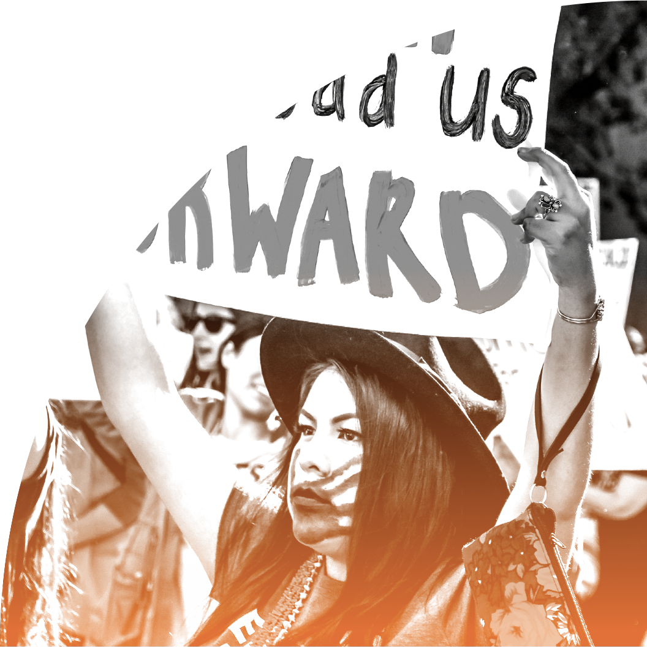
Youth Lead
in Advocacy
8
IMAGE: UNSPLASH
Notes:
[Ask:] Does everyone feel ready to be a leader now? [Generate responses.]
I think you would all be excellent leaders, and I hope you feel the same way about yourselves.
If you are ready to lead, one way you can do so is through advocacy.
[Ask:] But what is advocacy, anyway? What does it mean to be an advocate? [Generate responses.]

Slide 11
“The act or process of supporting a cause or proposal”
(Merriam Webster)
What Is Advocacy?
Issue advocacy: Attempting to fix a problem by attracting enough attention to it
10
Policy advocacy: Attempting to fix a problem through policy or legislation
Notes:
The dictionary definition of advocacy is “the act or process of supporting a cause or proposal.” Many different actions and activities can be involved in “supporting” a cause, from telling people about it to writing a letter to the editor of your local paper explaining its importance to organizing an entire campaign to push for positive change.
This slide defines two different types of advocacy: issue advocacy and policy advocacy. With issue advocacy, you notice a problem or issue and you do everything you can to raise awareness of the problem. The underlying expectation is that if enough people know about the problem and agree it is a problem, the problem will be fixed.
With policy advocacy, you notice a problem and do everything you can to change or create policy so the problem is addressed.
For example, say there is a river near your community, and your family and your neighbors eat the fish from that river and rely on its water for drinking, cooking, and cleaning. But the water is becoming polluted because waste from an upstream factory is leaching into it.
The issue advocate will make a lot of noise about this factory and may try to get their neighbors and friends to protest outside of it. They’ll hope the bad publicity they create will shut the factory down or get the people operating it to do something different with their waste.
The policy advocate, on the other hand, will research the problem and identify the root cause. Maybe the waste from the factory is getting into the river because the operators refuse to pay for proper removal. If so, the policy advocate might go to the local or national policymakers with their research, asking them to create a new policy that says that all factories must have eco-friendly waste removal systems.
This is the difference between issue advocacy and policy advocacy. In these training sessions, we will primarily focus on policy advocacy.

Slide 12
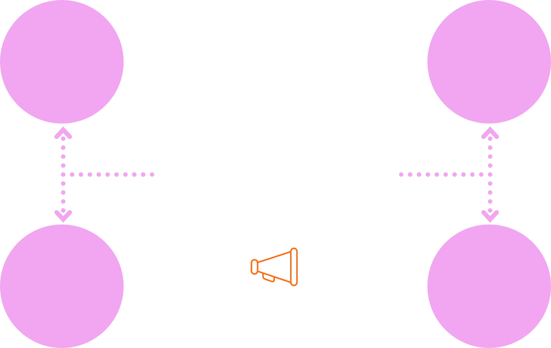
Policy affects everyone, youth included
Policymakers don’t often hear from youth
Why Should Youth Engage in Policy Advocacy?
9
Youth involvement makes policies stronger
Public participation is part of being a good citizen
Notes:
Why should youth get involved in policy advocacy?
First and foremost, it is everyone’s right to be involved in shaping the policies that impact their lives and their futures. Not only do young people deserve to be engaged in policy processes, but when youth are engaged and our perspectives are recognized and integrated, stronger outcomes can be expected. Youth involvement can lead to stronger policies on a range of topics, not only youth issues.
Young people have less life experience, but that is not always a bad thing. We come with fresh ideas because we may not know how things have always been done, and we are more willing to question the status quo.
Policymakers develop policies that apply to everyone, but they may not consider how specific policies may uniquely harm or disadvantage young people. This partly happens because they do not hear youth perspectives regularly, as they are usually surrounded by influential and powerful adults.
Another reason youth should get involved in policy advocacy is because public participation is critical to democracy, and for public participation to be representative of all the different groups that make up a society, youth must be included. When the public is involved in policy development, implementation, and budgeting, it’s more likely that recognized challenges in the community will be addressed by the government or other policymakers.
Public participation doesn’t just mean voting. It means attending events like public hearings, during which policymakers and the public have an opportunity to engage in dialogue. Youth are a part of the public and should have the opportunity to communicate with policymakers about their priorities.
Many governments, decisionmakers, and international organizations are starting to see youth as valued stakeholders in their communities and in the larger society, and it is more common for young people to be invited into policy spaces than it was in the past.

Slide 13
How Can Youth Leaders Influence Policy Change?
11
Engage with and educate peers
Participate in civic/community spaces
Share youth perspectives in meetings and/or public events
Amplify voices of underrepresented and marginalized groups
IMAGE: UNSPLASH
Notes:
Youth leaders like you are invested in improving the world we live in. But it is hard to know where to start, and how to influence the change process. How do we make our voices heard when too often our perspectives and experiences are discounted and ignored?
An easy first step to influencing change is finding like-minded people interested in working together toward the same goal. This may involve educating your peers on the policies that affect their lives or organizing an activity to raise awareness of a social problem.
Being a youth leader often requires us to participate in discussions and meetings that may not be meant for us. When decisions are being made on issues that affect you, you should be able to speak up and share your perspective.
[Ask:] Would you be able to speak up in a community meeting? [Generate responses.]
When youth leaders are given opportunities to speak in meetings or at conferences or events, you should also consider the perspectives of your peers. Young people with disabilities, youth living with HIV/AIDS, and those from historically oppressed and marginalized groups may have less access to these public forums.
[Ask:] How can you help to ensure their needs are heard and understood? [Generate responses.]

Slide 14
How Can Youth Gain Credibility?
12
Youth efforts backed by data and evidence are more effective
Data and evidence add depth to policy change messages
Data and evidence help to convince others to take you seriously
Research assists youth leaders in overcoming the challenge of being asked to represent “youth”
Notes:
Older people may feel they can dismiss the opinions of young people because they assume that we are inexperienced and don’t understand how the world works. One way to combat this perception is to demonstrate that we are knowledgeable by bringing relevant and persuasive evidence, data, and statistics into our advocacy messages.
[Ask:] What do we mean by data and evidence? [Generate responses.]
Evidence in this context simply means objective information. If we want something to change, we should be able to produce evidence that shows that the way things are currently operating is not perfect, and that the change we propose would improve the situation.
If you come to a policymaker with hard evidence, they are more likely to take you seriously. Your advocacy work should then be more effective. Whoever you are talking to will start to understand why you want things to change, and think more deeply about the issue. And when you demonstrate that you know what research says about your issue of concern, you demonstrate your expertise and are likely to gain respect as an individual rather than being expected to represent “the youth perspective.” What we mean by this last point is that sometimes youth leaders are asked very general questions that put them in a position of speaking on behalf of all youth. When faced with this dilemma, having data on different subsets of the youth population may be useful. Let’s walk through a sample scenario together to illustrate how data can be used to strengthen your participation as a youth leader.
Imagine that you are a youth leader serving on the steering committee for a Ministry of Health-led revision of the national adolescent health policy and youth are listed as a vulnerable group in the policy’s draft version. During a steering committee meeting, you are asked to offer feedback on young people’s health needs. What would you say? How would you want to prepare for that question? For example, you might say, “Young people face a variety of health challenges,” and then list some examples. This response is very general. But if you had data at your fingertips, you could offer a more nuanced answer. If you had researched in advance of the meeting and had data on hand, your answer could include things like the share of the youth population in your country that have a mental or physical disability and their unique health needs; the rates of new HIV infection among young, key affected populations; the small percentage of facilities that provide youth-friendly services; or a great many other specific, illustrative data points.
Specific data can be used to add depth to your input as a youth leader and can also be a way of delicately making the point that perhaps more young people should be involved in decision-making processes. For instance, in our hypothetical example with the Ministry of Health, imagine if, after sharing a statistic on youth living with disabilities in your country, you follow that point with an offer to put the steering committee in touch with another youth leader in your network who works for a disability rights organization. In this case, you could provide data on the diversity of youth experiences and needs and help make a connection between a decisionmaker and another youth leader. A win-win!

Slide 15
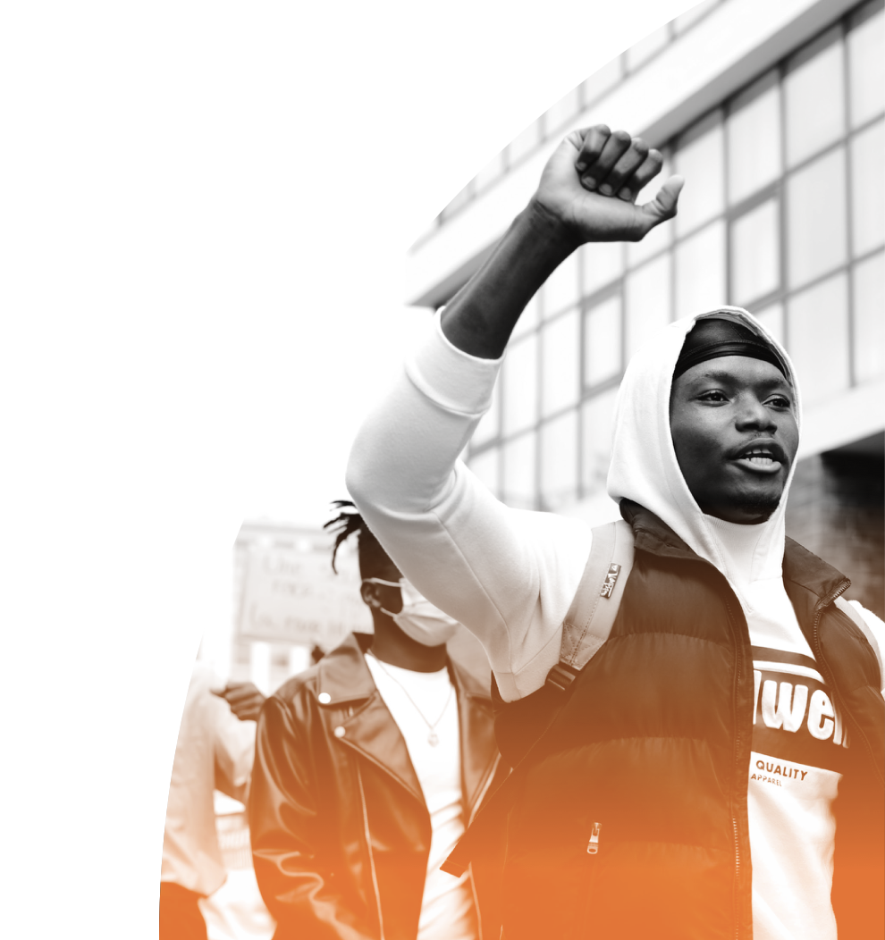
Summary
Youth leaders are important and can bring incredible change to their communities
Youth have a right to influence policy creation and change, and their involvement strengthens policy outcomes
Correctly using evidence can improve youth credibility and make advocacy more effective
13
IMAGE: UNSPLASH
Notes:
[Read slide.]

Slide 16
Do the Work!
14
Notes:
OK! Now that we have discussed how youth can effectively influence change, let’s hear from two young people who are making a big difference in their community using some of the strategies we just discussed.
In this video, we will meet Melati and Isabel Wijsen from Bali, Indonesia, who are working to rid their island of plastic pollution. Listen closely as they describe their campaign, because afterward you will answer questions about their tactics and activities.
[Click “play” icon to screen the embedded video. Distribute the Exercise 1.1B Worksheet, the Timeline document, and the FAQ document to participants. Divide them into small groups (4-5 participants per group) to complete the exercise. If time permits, bring everyone back together to debrief the activity as a large group.]
Video source: “Our Campaign to Ban Plastic Bags in Bali: Melati and Isabel Wijsen,” TED, 2016. Video, 11:00, https://www.youtube.com/watch?v=P8GCjrDWWUM.

Slide 17
Learn More
The World’s Best Youth Campaigns – And Why They Worked, Plan International.
Championing Change Through Advocacy, Voices of Youth, UNICEF.
Youth in Action, Climate Action, United Nations.
Join the Movement, IYAFP.
Notes:
SOURCES FOR UNIT 1.1:
Slide 3
Violet I. Murunga, “Progress for Kenyan adolescents as Ministry unveils new policy on sexual and reproductive health,” AFIDEP, September 17, 2015. https://www.afidep.org/progress-for-kenyan-adolescents-as-ministry-unveils-new-policy-on-sexual-and-reproductive-health/
Library of Congress, “Youth in the Civil Rights Movement” https://www.loc.gov/collections/civil-rights-history-project/articles-and-essays/youth-in-the-civil-rights-movement/
Plan International, “Girls help secure child marriage ban in Malawi,” https://plan-international.org/advancing-global-goals-girls-malawi
Bridger, Emily. “Functions and Failures of Transnational Activism: Discourses of Children’s Resistance and Repression in Global Anti-Apartheid Networks.” Journal of World History 26, no. 4 (2015): 865–87. http://www.jstor.org/stable/43901804

