Slide 1
Understanding
Unit 1.2
Policy
and the Policy Landscape
1
IMAGE: SHUTTERSTOCK
Notes:
Welcome back, advocates. If we want to fight for policy change, we must understand what policy is, where it comes from, and who/what influences it. The policymaking process can vary greatly across different institutions and countries, so you should reserve time to research the policy landscape in your community and country when you start to plan your advocacy campaign.

Slide 2
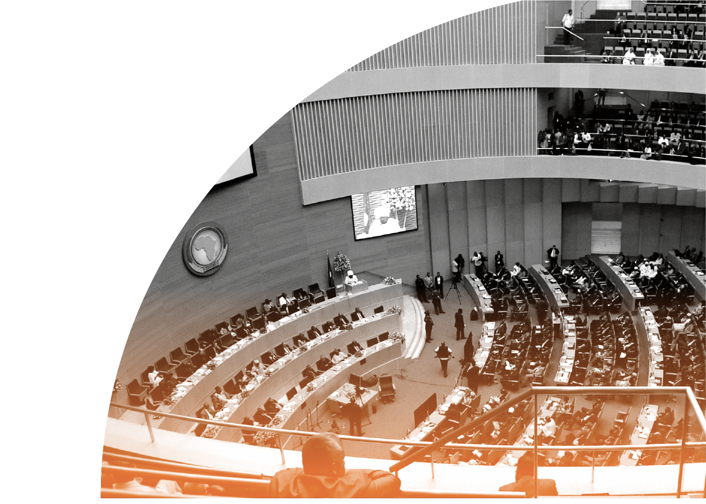
Where Is This?
2
IMAGE: PRB
Notes:
[Ask:] Does anyone know what this place is? What does this picture remind you of? [Generate responses.]
This is the African Union building in Addis Ababa, Ethiopia, where many policies are made. Here it is full of policymakers.
[Ask:] Is this place relevant to the work that you do? What are the other venues relevant to your policy work? [Generate responses].
The word “policy” often brings to mind images of high-level officials—the President, the Prime Minister, members of Parliament—or official documents. Indeed, policy can be all of that—but it can also be many other things.
[Ask:] So, what is the definition of policy? [Generate responses.]

Slide 3
What Is Policy?
DEFINITION
A course or principle of action adopted or proposed by a government, party, business, or individual
(Oxford English Dictionary)
LAW
Compels or prohibits behaviors
POLICY
Guides actions and laws toward a desired outcome
Notes:
Well, the dictionary tells us that policy is a principle or rule to guide decisions and achieve rational outcomes. Policies apply to government, institutions, organizations and groups, and individuals.
While laws compel or prohibit behaviors (for example, a law requiring the payment of taxes on income), policy merely guides actions and laws toward those that are most likely to achieve a desired outcome. We often think of policy in terms of national-level legislation.
[Ask:] Can anyone share an example of a policy? [Generate responses.]
Some examples are:
National Population Policy
Policies on Violence Against Women
Economic Development Policy
Trade Policy
Policy is a very broad term, and it is often used to describe laws and regulations, but it might also apply to strategy documents, funding decisions, institutional guidelines, or even traditional bylaws for small communities.

Slide 4
How the WHO Defines Health Policy
“Decisions, plans, and actions that are undertaken to achieve specific health care goals within a society. An explicit health policy can achieve several things: it defines a vision for the future, which in turn helps to establish targets and points of reference for the short and medium term.”
Notes:
The World Health Organization defines health policy as… [Read slide.]
So according to the WHO, health policy might describe decisions, plans, or actions—not just laws!—and it spells out the governing body’s vision for the future.

Slide 5
Where Do You Find Policy?
IMAGE: UNSPLASH
Notes:
This vision for the future can be expressed in different ways and found in different places.
[Ask:] Can anyone give an example of how policy might be communicated or documented? [Generate responses.]

Slide 6
Representations of Policy
POLICY DOCUMENTS
LAWS
CONTRACTS
PARTNERSHIPS
FUNDING PRIORITIES
Notes:
Here are some examples of places that policy shows up. Although we typically think of policy as part of government, it is important to remember that policy can also be organizational or private. Some examples include the policies for a specific hospital or health facility that direct how it is administered, or the strategic priorities for a private foundation that inform which activities they provide funding for.

Slide 7
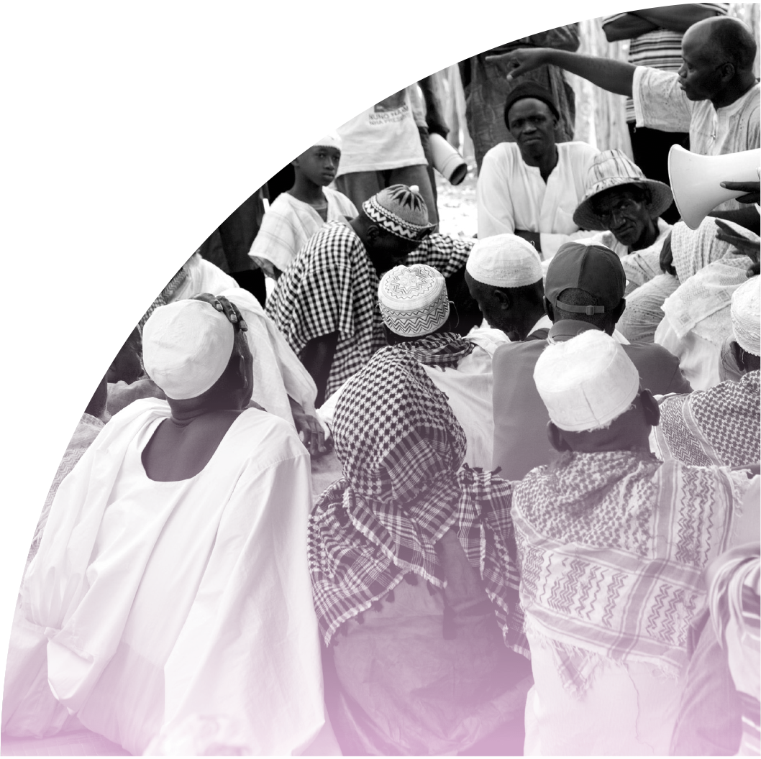
Who Are Policymakers?
Anyone with the authority to create or change a policy
IMAGE: PRB
Notes:
With that understanding of policy, a policymaker is anyone who has the authority to create or change a policy—and that policy could be any of the examples we just reviewed, such as policies, laws, and funding decisions.
As with policy, we often think of policymakers as high-level officials—such as presidents, ministers, parliamentarians, or councilmembers. But within our broad definition of policy, we also define policymaker broadly. Policymakers can be government officials, district-level leaders, officials within an organization, donor representatives, or bureaucrats.

Slide 8
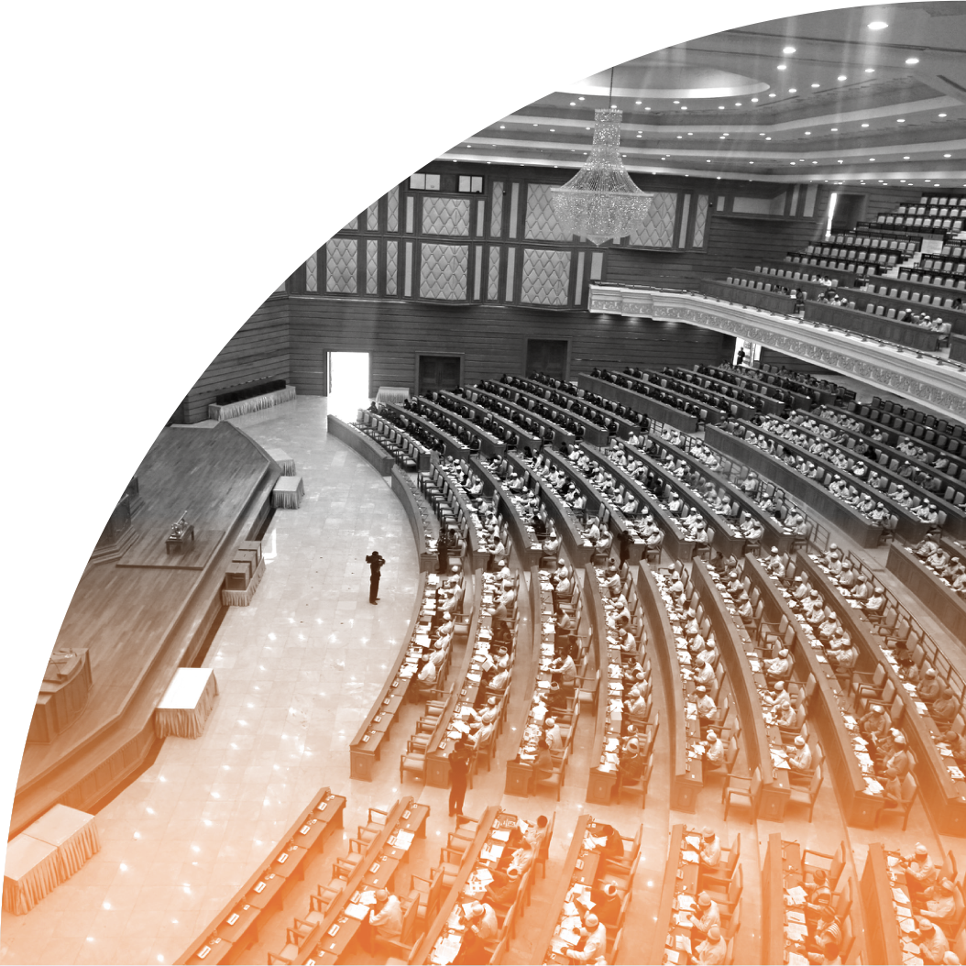
What Is the Purpose of Policy?
PHOTO BY: HTOO TAY ZAR
Notes:
[Ask:] Can anyone describe the purpose of policies? What is the point of creating them? [Generate responses.]

Slide 9
Why Create Policy?
To give guidance to action on a certain issue
To ensure that things happen
To change what is currently happening
To prioritize and allocate resources and issues
Notes:
Policies can be about basically anything, but usually they are meant to provide guidance or to set rules. Policies also demonstrate what issues are important to a community, institution, or nation.

Slide 10
One Policy Can Lead to Many More
IMPLEMENTATION: OPERATIONAL POLICIES
MULTISECTORAL IMPLICATIONS
Notes:
[Ask:] Has anyone heard of “operational policies”? Can you provide an example? [Generate responses.]
Operational policies are the instruments and practices by which organizations implement larger policies.
While national policies provide necessary leadership and guidance, operational policies are the means for implementing those policies. So, one major policy can trickle down to affect many other policies at different levels. Operational policies may be more directly related to or impacted by the research you are doing.
In addition, one policy may impact many sectors. Policies about education, gender, finance, inheritance, and the environment can all have implications for health. Conversely, many health policies have implications in other sectors. For example, policies related to young people accessing contraceptives might have implications for schools or for traditional bylaws. Research is critical to ensure that a given policy doesn’t have unintended consequences in other sectors. Public health is by its nature interdisciplinary; decisions made within these areas often have impacts on a range of other sectors.

Slide 11
Policy Can Be…
POLITICAL
MANAGERIAL
FINANCIAL
ADMINISTRATIVE
Notes:
In thinking about the operational policies and the different ways that policy is manifested, it can be useful to think in terms of these categories. Operational policies can be the political, managerial, financial, and administrative mechanisms arranged to reach explicit goals.
Political: This is the big picture. What are the overall goals or outcomes the policy or guidance aims to achieve?
Managerial: This directs how the activities or programs will be managed. Who is accountable or responsible for the activities in the policy?
Financial: This is where the money comes from. How will mandates of the policy be funded?
Administrative: This includes the processes or procedures of regulation and enforcement of a policy. What instructions guide the implementation of the policy?
Let’s think about a country’s family planning program as an example. [Ask:] Does your country have a national family planning program? [Generate responses.] Let’s think through of examples of policy mechanisms that apply to family planning programs.
Let’s start with the political. [Ask:] What are the goals of a family planning policy? Why does it exist? [Generate responses. Possible answer: A national family planning policy that states that all women and couples have access to contraceptive methods through community health workers.]
Next, let’s talk managerial. [Ask:] Who is accountable for the policy? [Generate responses. Possible answer: The Ministry of Health oversees implementation of CHW programs and ensures CHW training.]
Now, let’s consider the financial aspects. [Ask:] How are the population or family planning activities mandated in the policy paid for? How are the budgets determined? [Generate responses. Possible answer: Districts program their own health-related funds; the district budget-line for CHWs and for contraceptive supplies.]
Finally, let’s discuss the administrative aspects. [Ask:] How are family planning activities implemented? [Generate responses. Possible answer: CHWs receive stocks of contraceptive supplies on a regular basis based on their service logs of how many supplies they have provided.]
So as you can see, one big policy often requires a lot of smaller policies to be created to ensure the big policy is fully implemented.

Slide 12
Are ‘Non- Decisions’ Policy?
Sometimes governments or organizations choose not to take action on a policy issue
IMAGE: SHUTTERSTOCK
PHOTO BY JON TYSON ON UNSPLASH
Notes:
What about non-decisions? Sometimes governments or organizations choose not to take any action, or make any decision, on a relevant policy issue.
[Ask:] Do you think this is policy? [Generate responses.]
In some ways, this is a matter of opinion. Non-decisions certainly contribute to the context and the policy landscape on a given issue, which we’ll talk more about in a few slides. But in general, we are focused on policies that are written in some way—whether that is a formal policy, a strategy or guideline document, an official funding decision, or a publicly documented commitment.

Slide 13
The Policy Landscape
POLICIES
INDICATORS
FUNDING
STAKEHOLDERS
IMPLEMENTATION
Notes:
With this broad understanding of policy, we’ll now turn to how we can begin to understand the policy landscape for a given issue in a particular country or context.

Slide 14
Understanding the Policy Landscape
Who
are the stakeholders?
How
are these policies being funded and implemented?
What
are the policies that are in place?
Notes:
To begin to understand the policy landscape, you first need to know WHO is involved. We call these people the stakeholders—the people and groups who are affected by and who influence your issue.
Then, you need to know WHAT policies are in place. Are there national policies? Government policies at any administrative level? And if so (perhaps more importantly), what do they say? Are there gaps in the existing policy, or has the government chosen not to act on the topic?
Then, consider the HOW. How is enforcement of the policies funded? Are there donors funding, and thereby influencing, the programs? What is really happening with implementation of the policy?
Let’s start with the WHO.
[Ask:] Who can define “stakeholders?” [Generate responses.]

Slide 15
Who?
Stakeholders are people, groups, or institutions that are likely to be affected by a proposed intervention (either negatively or positively), or those which can affect the outcome of the intervention.
Identifying Stakeholders
Notes:
Stakeholders are people, groups, or institutions that are likely to be affected by a proposed intervention (either negatively or positively), or those who can affect the outcome of the intervention.
So identifying stakeholders begins with a brainstorm about who these people are.

Slide 16
Identifying Stakeholders
Who
is directly affected by the problem?
Who
is concerned and/or paying attention?
Who
has the power to fix the problem?
Consider “mapping” results by interest level, influence, or importance to your issue.
Notes:
Again, stakeholders can be individuals, groups, or institutions. Consider politicians, government bureaucrats, people who work in health or social services, representatives from civil society organizations, researchers, and media personalities. Think about who may be causing the problem or directly contributing to it—they are stakeholders who are likely to oppose your efforts. Also think about who is directly affected by the problem and therefore would be most invested in whether or not it is addressed.
You should consider “mapping” the stakeholders you identify through the brainstorming process. Common criteria for mapping the stakeholders, by which we mean organizing the stakeholders graphically, are their interest level in your topic and their degree of influence over the issue, or how important they are to the issue. A simple Google search of “stakeholder mapping” or “stakeholder matrix” will give you a LOT of examples and ideas.

Slide 17
What?
Examining Policies
IMAGE: SHUTTERSTOCK
Notes:
The next information to gather is what policies, strategies, or action plans are already in place.

Slide 18
What Policies Are in Place?
Are there recent
developments or public statements?
Does it address implementation?
What other policies or strategies address this topic?
Is there a dedicated policy for the given topic?
What are the stated objectives of the policy?
Does it specify funding?
Notes:
Questions to consider include:
Is there a dedicated policy for the given topic? And is it at the appropriate level—national, district, facility, or another level?
What other policies or strategies address this topic? Sometimes policies have an associated strategic plan. Sometimes there may be a national-level policy, but a district-level strategy or implementation plan is required to direct how the policy will be implemented in a given district.
What are the explicit objectives of the policy?
Does the policy specify how it will be funded? If not, are budgets at the appropriate level funding the programs or activities specified by the policy?
Does the policy say how it will be implemented? Or is there a separate implementation plan document?
Are there any recent developments that might impact these policies? Have any officials or influential stakeholders made public statements or commitments regarding the issue? Knowing what your leaders have committed to, and comparing that to the reality of the policy landscape, is a way of holding leaders accountable.
You’ll need to consider how the government and policymaking in your country is organized. Are decisions (including policies and funding) made at the national level? Regional or district level? Is there a national-level policy that relates, directly or indirectly, to your issue?

Slide 19
Policy Analysis
What does the policy actually say?
Notes:
Then you must ask—what does the policy actually SAY?
Are the key terms defined? What groups are named, and what could be left to interpretation? For example, in a national family planning policy, are unmarried women specifically named with the right to access contraceptives, or could that be left to interpretation?
There are many approaches to policy analysis that look critically at the actual language of the policy. One approach is to use World Health Organization (WHO) guidance to analyze the text of the policy. See where the policy explicitly addresses WHO recommendations and where there are gaps in addressing those recommendations. WHO guidance documents are available for a variety of health areas. Here, we show example guidance documents for medical eligibility for contraceptive use and ensuring human rights with contraceptive services.

Slide 20
How?
Judging Implementation
IMAGE: SHUTTERSTOCK
Notes:
Next, the question is: What is really happening? We know who the stakeholders are. We know what the policy says. But what is really going on?

Slide 21
KEY INFORMANTS
Policy Implementation Assessment
Policymakers
Health professionals
Civil society
Experts
CURRENT INDICATORS
IMPLEMENTATION SCIENCE AND ACCOUNTABILITY RESEARCH
Beneficiaries
Notes:
Policy implementation refers to the mechanisms, resources, and relationships that link health policies to program action—this includes all the operational policies we discussed in previous slides. A policy implementation assessment looks at how a given policy is translated into action. Many countries have policies in place for the issues you are considering—but the implementation may be an issue. A policy implementation assessment is a way to hold leaders accountable by determining which commitments are being translated into action.
One piece of data to consider is current indicators. Depending on the issue, information may be readily available in a DHS or national-level survey. If you’re exploring the family planning policy environment, what do the indicators tell you about who is using family planning? What kind? From what type of provider?
Consider implementation of the policy. If the national family planning policy gives women the right to access contraceptives, do health facilities actually provide contraceptive services? Do they have contraceptive supplies? Are the hours amenable to the women who seek services? Are fees being charged formally according the policy fee schedule? Are “informal” fees (such as tips for the purchase of individual medical supplies) being charged?
Valuable information also comes from key informants within the stakeholder groups. These are individuals who have firsthand experience implementing or monitoring the policy and can provide insight on what is happening. Stakeholders may be able to speak to how politics, beliefs, values, or social norms may be influencing the policy context.
A full-scale policy implementation assessment to determine what’s really happening is equivalent to undertaking a large-scale research activity—and simply not possible for most individuals or small organizations. So, it’s important to consider the question of implementation, and seek out what information might be readily available. Maybe another group has undertaken the research and it’s published on their website or in a journal. Maybe you can use your networks to have a formal or informal interview with a key informant, such as a nurse or an official from the Ministry of Health.

Slide 22
Taking Gender Into Account
Policies affect all genders and sexes differently
Gender norms and roles affect health
Policies provide an opportunity to identify and remove these inequalities
IMAGES: SHUTTERSTOCK
Notes:
Another important factor to consider in the policy landscape, and any type of policy assessment, is gender.
Integrating gender into policy development, advocacy, and implementation ensures that the needs of women and men, girls and boys, and all genders and sexes are considered and addressed.
Health policies often affect women and men, girls and boys, and LGBTQ individuals differently. These differences are often the result of local gender norms and values that shape the freedom and opportunities open to women and men and boys and girls in society. In many countries where women may depend on men for livelihood needs such as food, shelter, money for medical treatment, and school fees for children, they also are more likely disadvantaged in learning to read, finding appropriate transportation, and accessing family planning information and services.
Women frequently have less control over their reproductive health than do men, and sometimes need permission from a male family member to travel to a health facility or to access contraception. Therefore, policies that address these issues need to consider gender and gender norms carefully.
Men also face gender norms that increase their health risks. They tend to seek health care less often than women and thus have less interaction with health providers.
Policies provide an opportunity to identify and remove these inequalities. In fact, policymakers and other stakeholders must identify and remove these gender inequalities—whether they result from oversights in policy or breakdowns in implementation—before health improvements are possible.

Slide 23
POLICY
Guides action
Achieves goals
Different mechanisms at many levels
Summary
POLICY LANDSCAPE
Stakeholders
Policy documents
Implementation
Notes:
In summary, the key points to take away from this session are that policies are meant to guide action and achieve goals, and are put in place through a variety of mechanisms at many different levels.
Understanding the policy landscape for a given issue is an important first step as you consider the policy implications of your research or topic. Important components of a policy landscape assessment include the stakeholders, the policies and what they say, and the implementation of the policies—translating the words in the documents into action.

Slide 24
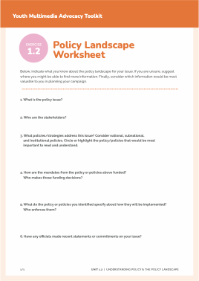
Do the Work!
Using the worksheet, apply the concepts from this presentation to examine the policy landscape related to your advocacy issue.
Notes:
Now it is time to do some work!
[Read slide, organize participants into small groups (3-5 individuals per group), and distribute an Exercise 1.2 Worksheet to each group. Collect the completed worksheets or ask participants to keep track of them—you will refer to them in future sessions. If you have time, you may want to ask some participants to share their answers with the rest of the group and have a short discussion.]

Slide 25
Learn More
Harry Cross, Karen Hardee, and Norine Jewell,
Reforming Operational Policies:
A Pathway to Improving Reproductive Health Programs, Occasional Paper #7, Futures Group: The Policy Project, 2001.
Health Policy Initiative,
“Policy Implementation Assessment Tool.”
Christine Power, Youth Family Planning Policy Scorecard, PRB, 2021.
Andy Sumner et al.,“What Shapes Research Impact on Policy? Understanding Research Uptake in Sexual and Reproductive Health Policy Processes in Resource Poor Contexts,” Health Research Policy and Systems 9, supplm 1 (2011):S3.
Notes:
UNIT 1.2 SOURCES
Slide 4
WHO, Health System Governance, https://www.who.int/health-topics/health-systems-governance#tab=tab_1

