Slide 1
MODULE 2
Effective
Communication
Notes:
Welcome to Module 2! You’ve learned the basics of leadership, advocacy, and policy development. For the next few sessions, we will focus on strengthening our communication skills so we can effectively convince policymakers that change is needed and convince others to support our advocacy efforts.

Slide 2
Unit 2.1
Storytelling
for Policy Change
1
IMAGE: SHUTTERSTOCK
Notes:
In this session, we will talk about storytelling: why it matters, how to tell a good story, and where storytelling fits into policy advocacy.

Slide 3
Storytelling For Policy Advocacy
Identify Your Audiences
Select Your Communication Strategies
Craft Key Messages
Notes:
In approaching storytelling for your advocacy work, you should also think of yourselves as journalists and researchers.
In this training, we will blend skills and ideas from both multimedia storytelling and policy advocacy. Whether you are telling a story or advocating for policy change, to do it effectively you should: 1) identify your audience, 2) select your communication strategies, and 3) craft your key messages. Remember these steps, because they will come up repeatedly in these sessions.
You should frame your story differently for different audiences. You may use different words, you will likely use a different tone, and you certainly will highlight different elements depending on who you are attempting to reach.

Slide 4
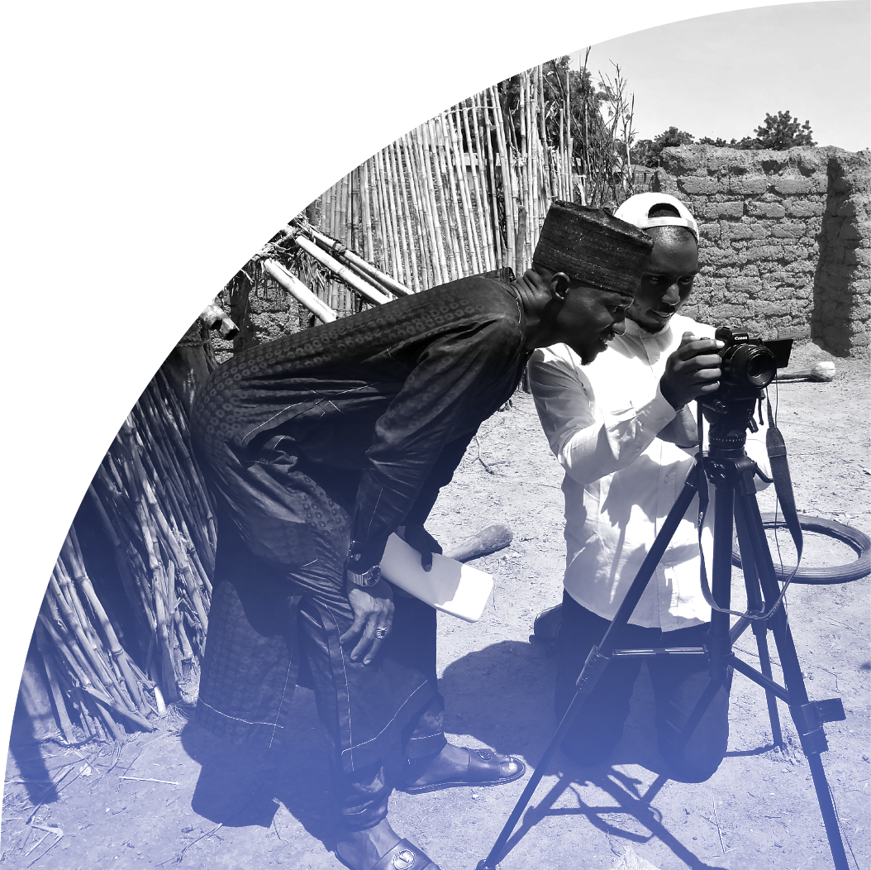
Why Do We Tell Stories?
IMAGE: Bridge Connect Africa Initiative
Notes:
People have been telling stories since the very beginning of civilization. Every culture, community, and family has their own stories that are told over and over again, passed down through the generations.
[Ask:] Why do you think this is? Why do we tell stories? [Generate responses.]
Research has shown that people retain six times more information when it’s shared in a story rather than conveyed using data alone. Stories can move us, change us, and compel us to act—making them important and effective tools for social change. Certain qualities of stories make them especially compelling.
One quality is memorability: Stanford professor Chip Heath had students each give a one-minute presentation on a particular topic. In the average one-minute speech, the typical student used 2.5 statistics. Only one student in 10 told a story. Ten minutes after the speeches ended, he asked students to recall information from the speeches. The students were flabbergasted at how little they remembered. There wasn’t a huge amount of information to take in—at most they heard eight one-minute speeches. And yet the students were lucky to recall one or two ideas from each presentation. Many drew a complete blank on some speeches, unable to remember a single concept. When students were asked to recall the speeches, 63% remembered the stories, but only 5% remembered any individual statistic.
Another important quality is persuasiveness: In another study, researchers tested two variations of a brochure for the Save the Children charity organization. People who received the story-based version of the brochure donated an average of $2.38, while those who received the infographic-based version donated an average of $1.14. Various statistics on the plight of African children were far less persuasive than the story of Rokia, a 7-year-old from Mali.
Then, there’s engagement: The brain of a story reader or listener mirrors that of the storyteller, creating an emotional connection. When sensory details are described, parts of the brain light up as if we are actually experiencing those senses, imprinting the experience in our brains, which is why we retain stories better than data alone. When taking in stories, people enter into a trance-like state, where they drop their intellectual guard and are less critical and less skeptical. Rather than nitpicking over the details, the audience wants to see where the story leads.

Slide 5
What Makes a Good Story?
PHOTO BY JAKOB OWENS ON UNSPLASH
Notes:
Now that we’ve discussed why we tell stories, let’s think about what makes a good story.
[Ask:] Any ideas? What makes a story compelling to you? [Generate responses.]

Slide 6
The Narrative Arc
CLIMAX
Rising action
Falling action
Resolution
Inciting incident
EXPOSITION
DENOUEMENT
Notes:
Most good stories have a narrative arc that looks something like this.
[Ask:] Can anyone explain what this image is telling us? [Generate responses.]
Narrative arc is a term that describes a story's full progression. It visually evokes the idea that every story has three parts:
a relatively calm beginning.
a middle part where tension, character conflict, and narrative momentum build to a peak.
and an end where the conflict is resolved.

Slide 7
Make Your Stories Resonate By...
1
2
3
4
Getting personal
Being relatable
Staying simple and focused
Using multimedia!
5
6
Considering social media
Showing instead of telling
PHOTO BY ELIA MAZZARO ON UNSPLASH
Notes:
Your story will resonate more with your audience if it has certain characteristics.
First, get personal. Personal stories, especially those that touch on triumph over adversity, engage people at a deep level.
It also should be relatable. If your audience can see themselves in the characters or the situation, if they can relate to your story, they will pay more attention.
It should also be simple and focused. That means one or just a few characters and one key message, with just the essential elements. It should only take you between 30 seconds and 2 minutes and 30 seconds to tell your story.
It should also use multimedia approaches: Compelling stories include multiple presentation methods, including audio, visual, video, text, and data visualization.
Include some social media-friendly elements: A story is better suited to social media if it has an enticing opening; is concise; and is shareable online.
Finally, your story should shows rather than just telling: Instead of telling your audience about a certain event in a story, try showing them by transporting them to the scene. Describe the setting or characters with vivid details, give a scene-by-scene construction of events, and use dialogue when possible.

Slide 8
Cooking Up a Good Story
DIRECTIONS
INGREDIENTS
Set the context
Introduce the characters
Show the conflict
Show the turning point
Demonstrate why it matters
End with a call to action
Interviews and narration
Video and animation
Graphics and photos
Data and evidence
Quotes and descriptions
Notes:
There are varying versions of the list of “essential components” of a story. But for our purposes, this is the storytelling recipe we should follow if we want to convey our messages effectively. The recipe directions will be the same for nearly any product or story, but the ingredients will change depending on our audience and what elements best resonate with them.
First we start by setting the context. Where does our story take place? What does the environment look like? If you use photos and videos, you can show the environment. If you are using animation, you will have to recreate the environment. If you are only using audio (like a radio series or podcast), you should use natural sound or narration to help your listeners picture the environment in their heads.
Next, introduce your audience to the characters in your environment. Decide if you are following one individual, a family, a group of friends, or others. You want your audience to identify with your characters—either they see themselves represented through one of them, or they know people like your main character or characters. The characters in your story should ideally be interesting and relatable.
Then, as we discussed earlier, your characters should progress through a narrative arc, which includes a conflict and a turning point or climax where the situation starts to resolve.
Your story should clearly demonstrate why your advocacy issue matters in a way that the audience can hear and understand.
And end with a call to action. What do you want your audience to do now to make a difference?

Slide 9
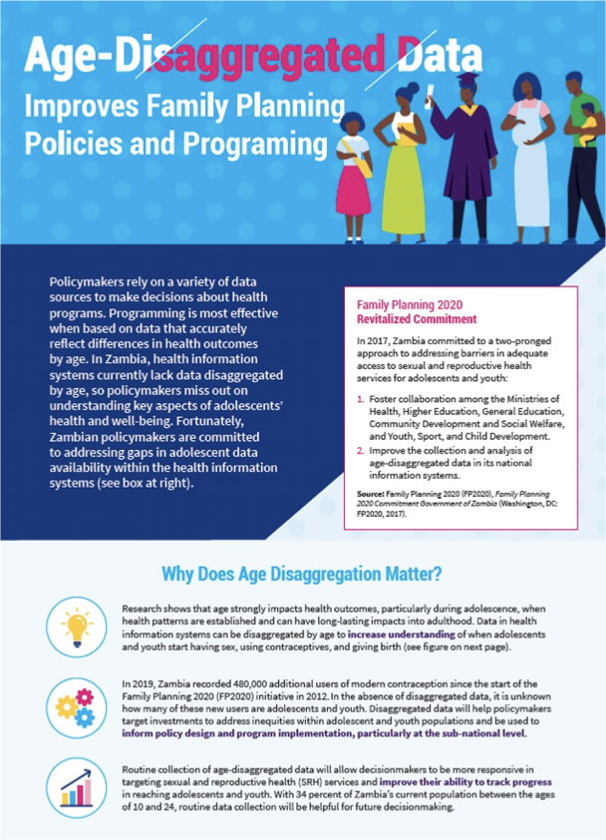
Case Study Age- Disaggregated Data
Notes:
This is a fact sheet PRB produced focused on the importance of age-disaggregated data in Zambia, and although it has a strong advocacy message, it brings in storytelling elements to make the information more compelling.
[Facilitator note: You can find the PDF version of the factsheet here: https://www.prb.org/wp-content/uploads/2020/05/eeda-zambia-fact-sheet.pdf. You may find it easier to zoom in and review the components by viewing in a PDF viewer rather than on the slide].
[Ask:] In this example, can you find all the ingredients of the recipe? [Generate responses. (Correct answers are below).]
Context: The section “Why Does Age Disaggregation Matter?” clearly set the scene and explains why you should care about this topic.
Characters: There are both visual characters (community members of different ages) and written characters (the Zambian policymakers making commitments).
Conflict: Zambia is missing opportunities to disaggregate national data!
Turning point: You can clearly see the turning point signaled by the words “A Path Forward.” This section talks about how to resolve the problem presented and overcome the conflict.
Messages (+call to action): There are many messages throughout this fact sheet, but you can easily identify the “call to action” at the end. Three clear recommendations are laid out for readers.

Slide 10
“
When we reduce a person’s story into a simple ‘they were in this super traumatic experience and now they’re free and everything’s great’—it doesn’t tell the whole story. So, when we tell the story of an individual, we want to acknowledge their strength, their courage, their resilience, and also identify the challenges that they still experience, because we know that healing exists on a spectrum...We strive to remember that every story shared with us is the story of an individual who is worthy of dignity, and who is not defined by their story alone.”
—Madeline Kronenberg, Dressember Foundation Communications Manager
Notes:
Here is a great quote about ethical storytelling.
[Ask:] Would someone like to volunteer to read this quote aloud?
[After quote is read:] We need to avoid oversimplifying anyone’s story. Do the best you can to help your audience understand the complexities of the situation and your characters’ lives.

Slide 11
Common Story Pitfalls
Too complex
Too simplistic
Inaccurate
Unethical storytelling
Inauthentic
No call to action
Harmful stereotypes or messaging
PHOTO BY ROSARIO NUÑEZ ON UNSPLASH
Notes:
There are some common pitfalls people experience when trying to tell stories:
First, if your story is too complex, you will lose your audience, and they may not get your message.
On the other hand, if your story is too simplistic—if you treat complex issues and problems as if they were much simpler than they really are—this can spread misconceptions about the issue, diminish your credibility, and lead to the development of solutions that do not adequately address the issue.
In addition, if your story is inauthentic, or seems fake, you’ll lose your audience. How can you make sure the story you’re telling is authentic? Speak to an issue you have personal experience with or involve people who are personally affected by the issue. And if there are multiple sides to or perspectives on the issue, acknowledge and address them whenever possible.
Next, if your story contains medical, scientific, or legal inaccuracies or contributes, even inadvertently, to harmful stereotypes or messaging, it will do more harm than good. Avoid these situations by having a medical, scientific, or technical advisor—as well as people who are personally affected by your issue and who live or work in your context—review your story before you share it too widely.
Also, if you make a great story, but there is no call to action, you’ve missed an opportunity to create change. Make sure your audience knows what steps they can take to support your cause after they’ve heard your story.
Finally, ignoring ethical storytelling practices can put those who participate in your storytelling process at risk for damage to their reputation or even physical harm. Let’s take a minute to go over a few principles of ethical storytelling.

Slide 12
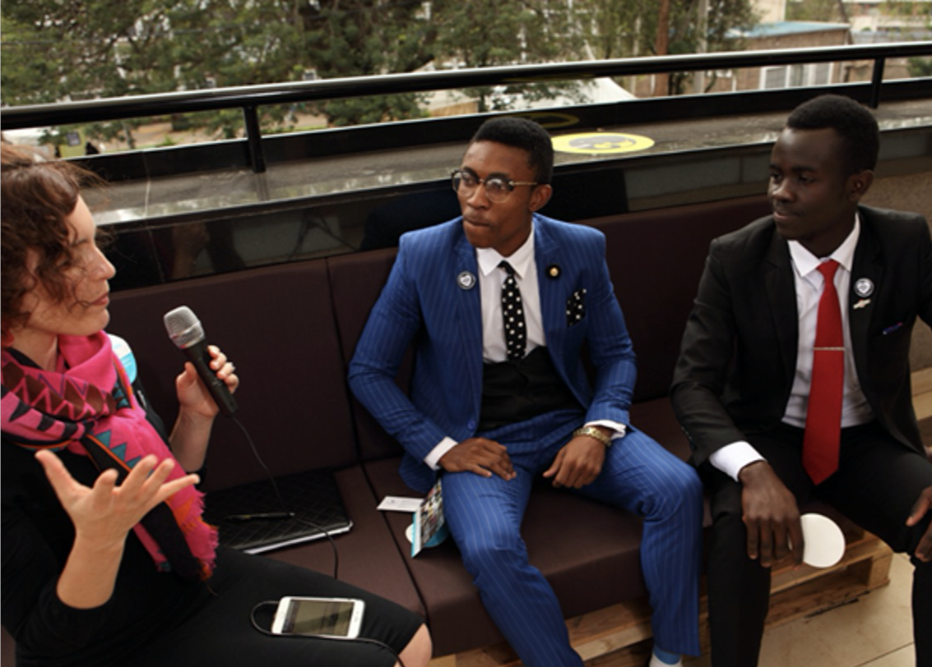
Ethical Storytelling
Consent
Respect for personal boundaries and cultural norms
Review and approval
Honesty and accuracy
Citations and credit
PHOTO BY DAVID ALEXANDER, CCP
Notes:
The “Ethical Storytelling” movement recognizes that it not only matters that stories are shared and that advocates and donors understand the impact they are making—it also matters how stories are shared.
There are several strategies for making sure you're engaging in ethical storytelling.One way is to ensure you obtain recorded oral consent or asking your subjects to sign a consent form. Be sure to clarify how content will be used. You should also discuss what participation entails, the benefits and risks, privacy and confidentiality issues, and the use of identifiers in your story. Your participants should also know who to contact with questions.
Also, consider personal boundaries and paying attention to subject’s body language/comfort level. If your interview subject wants to stop or seems uncomfortable, you should pause and try to address whatever is making them uncomfortable.
Always respect cultural norms. What is acceptable in one culture may not be acceptable in another. Familiarize yourself with cultural norms and expectations before you go into a new community to conduct interviews, and then behave appropriately.
If you are able, allow participants to review and approve final content (the quote or video clip of them you want to use) before you start sharing it. Ensure they are satisfied with how they are portrayed.
Finally, be honest and accurate in everything you publish, and include citations that appropriately credit your sources.

Slide 13
Who Will Hear Your Story?
PHOTO BY LEOHOHO ON UNSPLASH
Notes:
Now that we know why stories matter and have discussed what makes a good story generally, we are going to spend some time thinking about how to frame our stories appropriately to reach our target audience(s). Who do you want to reach with your story? What matters to them?

Slide 14
The Audience
Age range
Time and attention span
Gender
Who is my story for?
Networks and influencers
Geographical context
Format and channel preference
Level of education
Social, cultural, and religious context
Access to technology
Notes:
Before you do anything related to developing your story, you need to think about your audience. How old are they? Where do they live? What values do they hold? Are they religious? How educated are they? Do they use computers and the internet or not? Who do they listen to? These answers will factor into how you frame and share your story.
Your story should meet your audience where they are. You cannot control where your audience goes for information or who they are as individuals, but you can control where and how you share your story.

Slide 15
Segmenting and Narrowing Your Policy Audiences
PRIMARY AUDIENCES
SECONDARY AUDIENCES
People who have direct control and authority to affect policy change
Individuals or groups who can indirectly influence or motivate primary audiences to act
Notes:
There are many audiences out there, and unfortunately, we cannot reach them all. As a result, before we can craft our story, we need to segment and narrow our audiences. If we are advocating for policy change, we want to reach a policy audience.
Our primary audiences are those who have direct control and the authority to affect policy change.
Our secondary audiences are those who can indirectly influence or motivate our primary audiences to take action.
For example, asking a local journalist to write a story about a critical problem affecting access to contraceptives could motivate a local leader to allocate resources toward improving contraceptive access for the community.
Or youth advocates could team up online to Tweet at a state governor to pass a law that prevents child marriage.
Both audience types can exist across levels—such as global national, or subnational—but it is important to select only audiences that you can realistically reach and engage. Think critically about who you need to reach and who would be nice to reach, while keeping in mind the unique networks and connections your organization holds. Then, once you have a clear picture of who your audience is, you can put some thought into ensuring the words you use in your story bring your advocacy issue to life in a way that resonates with them.

Slide 16
Case Study Family Planning for Youth
Investing in contraceptives for young people to save money in Mombasa County
Notes:
We’re going to watch a short video created by PRB, and I want you to pay attention to what we just discussed.
[Click video to play. Video source: The video link is https://www.youtube.com/watch?v=ORL-2XKBqKw.]
[After watching the video, ask:]
Can you identify the audience or audiences? [Generate responses.]
What information is shared with them? [Generate responses.]
What is their call to action? [Generate responses.]

Slide 17
Storytelling With Multimedia
IMAGE: BREAK FREE FROM PLASTIC AWARENESS INITIATIVE
Notes:
Now that we’ve got a good handle on storytelling, we are going to briefly explore how to make our stories more powerful using multimedia. (We will go into more detail on this topic in Module 3).

Slide 18
What is Multimedia Storytelling?
A combination of text, photographs, video, audio, and/or graphics (such as maps, charts, and gifs)
Interactive and nonlinear!
Usually presented and shared online
Includes complementary (not redundant) information and media
IMAGE: SHUTTERSTOCK
Notes:
So, what is multimedia storytelling? Multimedia stories include some combination of elements, are interactive and nonlinear, are presented and shared online, and are complementary (meaning the pieces don’t stand alone—they are integrated into one story). Most multimedia stories require that the reporter go into the field to report the story face-to-face with sources, rather than doing a story entirely by phone or email.
When you create a story for the web—including using a video camera to shoot interviews or events, using a camera to take still pictures, or recording audio to collect information for text or graphics—what you gather can be used to produce a multimedia story, a television story, a print story, or a radio story. The best multimedia stories are multi-dimensional, bringing in all of these.

Slide 19
Elements of Multimedia Stories
Photos
Text
Audio
Graphics
Video
Notes:
Types of multimedia elements include:
Photos: Still photos are the best medium for emphasizing a strong emotion, for staying with an important point in a story, or for creating a particular mood. They’re often more dramatic and don’t go by as quickly as video. Still photos used in combination with audio also highlight emotions. Panorama or 360-degree photos, combined with audio, also immerse a reader in the location of the story.
Audio: Good audio makes still photos and video seem more intense and real. Bad audio makes video seem worse than it is, and it detracts from the drama of still photos. Whenever possible, try to add the transcript of the audio.
Video: Video is best for depicting action, for taking a reader to a place central to the story, or for hearing and seeing a person central to the story.
Graphics: Graphics can include maps, charts, illustrations, and gifs. They can help us demonstrate a location, display data, or create our own characters. Gifs, or animated graphics, show how things work. Graphics go where cameras can’t go: into human cells or millions of miles into space. Sometimes graphics can be a story’s primary medium, supported by other media.
Text: Text can be used to describe the history of a story or a process, or to provide accounts of an event. It can be used to deliver your key message quickly to your audience in a specific way that other elements cannot.
[Facilitator note: If you have time and internet access, you may want to explore some of these links as examples of multimedia stories, like the ones shared on this website: https://shorthand.com/the-craft/impressive-digital-stories/index.html].

Slide 20
Do the Work!
Write a short story (less than one page) about an individual or family affected by your advocacy issue. This story can be true or from your imagination. Try to use the narrative arc structure and end with a call to action.
Notes:
OK, storytellers. Time to practice your new skills!
[Read slide. Hand out paper/pencils for exercise if appropriate (participants can use their computers if accessible/preferred). Allow 10-30 minutes for participants to write their stories, then share with the group if there is enough time. Participants should hold onto their stories as they will revisit in Exercise 3.4.]

Slide 21
Learn More
Knowledge for Health and Family Planning 2020. Family Planning Voices Storytelling Toolkit, (2016).
Swipe Out Hunger, Storytelling as an Advocacy Tool.
Jane Stevens. Multimedia Storytelling: Learn the Secrets from Experts. Berkeley Advanced Media Institute (2020).

