Slide 1
Unit 3.5
Social Media
for Social Good
1
IMAGE: SHUTTERSTOCK
Notes:
Welcome to our training on using social media for social good. This is our final session! Congratulations on making it to the end of the multimedia advocacy toolkit.
To close out, we are going to discuss how we can thoughtfully and effectively use social media to expand our reach and bring us closer to achieving our advocacy goals.

Slide 2
Why Is Social Media Important?
IMAGE: SHUTTERSTOCK
Notes:
Most of us are familiar with social media and have accounts we use regularly. There are lots of different social media platforms in the world and new ones seem to be popping up all the time.
[Ask:] How would you define the term “social media”? [Generate responses.]
The Merriam-Webster dictionary definition of social media is: “forms of electronic communication (such as websites for social networking and microblogging) through which users create online communities to share information, ideas, personal messages, and other content.”
Social media platforms fall into six categories:
Sharing is one most of us are familiar with. These platforms are meant for sharing content, such as videos, photos, and information. YouTube, Pinterest, and Instagram are examples.
Messaging is another category of social media. Platforms with messaging allow users to send direct messages to individuals or groups—think of email, texting, or chatting online. WhatsApp and Gmail are messaging platforms.
Other platforms are built for discussion. Reddit and Snapchat are examples of discussion platforms where people gather to discuss current events or shared interests.
Collaboration platforms allow users to share professional content for workplace cooperation. Dropbox, Slack, and Microsoft Teams are examples of collaboration platforms.
Then there are networking platforms. These platforms—like LinkedIn—focus on making connections with people and building professional relationships.
And finally, social publishing platforms allow anyone to publish content they developed with others and to receive feedback. Here we tend to think of blogs, but Wikipedia is also an example.
And then there are many platforms like Facebook, Twitter, and LinkedIn that can be used for several of these purposes.

Slide 3
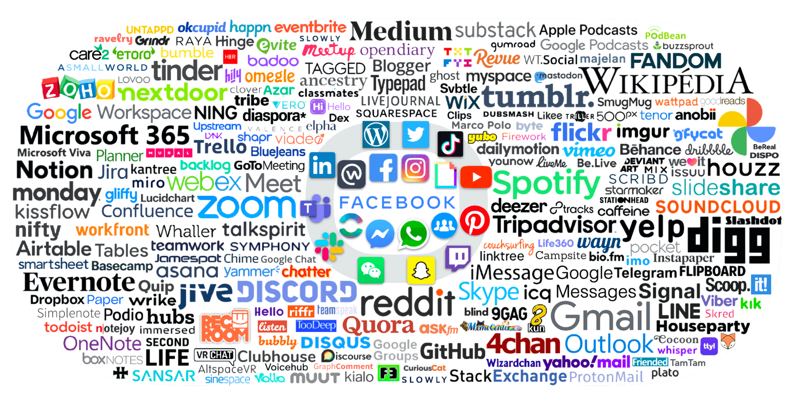
The Social Media Landscape
Publishing
Networking
Sharing
Collaborating
Messaging
Discussing
SYSK
SOURCE: FREDCAVAZZA.NET
Notes:
As advocates, why should we care about social media? One reason is because of the audience! Nearly everyone with access to the internet will use social media at some point in their lives. Social media platforms allow us to reach an audience of hundreds or thousands of people with a single click.

Slide 4
Social Media for Policy Advocacy
Keep track of the latest research
Engage with influential people and organizations
Raise visibility of your issue and work
Build advocacy networks
Notes:
When we think of social media, we often think of it in the personal sense—networking with friends and family to share life updates, photos, and videos. Social media for policy advocacy is the use of digital technology to contact, inform, and mobilize a group of concerned people around an issue or cause. The purpose of social media advocacy is to galvanize supporters to take action.
Digital tools have become a central component of almost any movement. Some of the most-used digital advocacy tools include websites, blogs, Facebook, Twitter, email, and text messages. Literally hundreds of social media applications exist that could be used for digital advocacy, but to get started, spend your time and resources where your supporters are most likely to be (Facebook and Twitter are good bets). Then integrate your efforts for better overall results.
In addition, social media has become an important medium for keeping track of research relevant to your advocacy issue. Social media platforms allow us to gather information from experts, including researchers and academics. Before the internet, you might have had to subscribe to a scientific journal and wade through pages of very difficult language to understand the latest research on issues you cared about. Now, researchers can hop on Twitter or Facebook and tell you and everyone else, in simple terms, about their findings. Of course, non-experts can do the same thing, so it is important to critically evaluate the source of your information, especially when it comes from social media.
It’s also vital to building advocacy networks. Social media is a key tool in building awareness and credibility. When integrated into advocacy and multimedia campaigns and activities, social media can encourage participation, conversation, and community—all of which can help spread key messages, influence decision-making, and push for policy change. Social media also helps to reach people when, where, and how it is convenient for them, which improves the availability of content and might influence satisfaction and trust in the messages delivered.
Social media also helps us engage with policy audiences, and other kinds of influential audiences. More and more, Ministries and individual policymakers have social media profiles. Some are active, while others might engage rarely. Donors, NGOs, research institutions, civil society organizations, and journalists are often active. At the same time, we see that individuals who might not otherwise be viewed as influential can start to build a social media presence and assert themselves as an authority or thought leader within the social media sphere.
Lastly, social media helps us increase visibility. Take advantage of the reach social media gives you to make people aware of what you are doing and why it matters. Amplify your key messages. Share news articles relevant to your advocacy issue. People who follow you on social media should come to think of you as a subject matter expert, and they will be interested in your thoughts and your work.

Slide 5
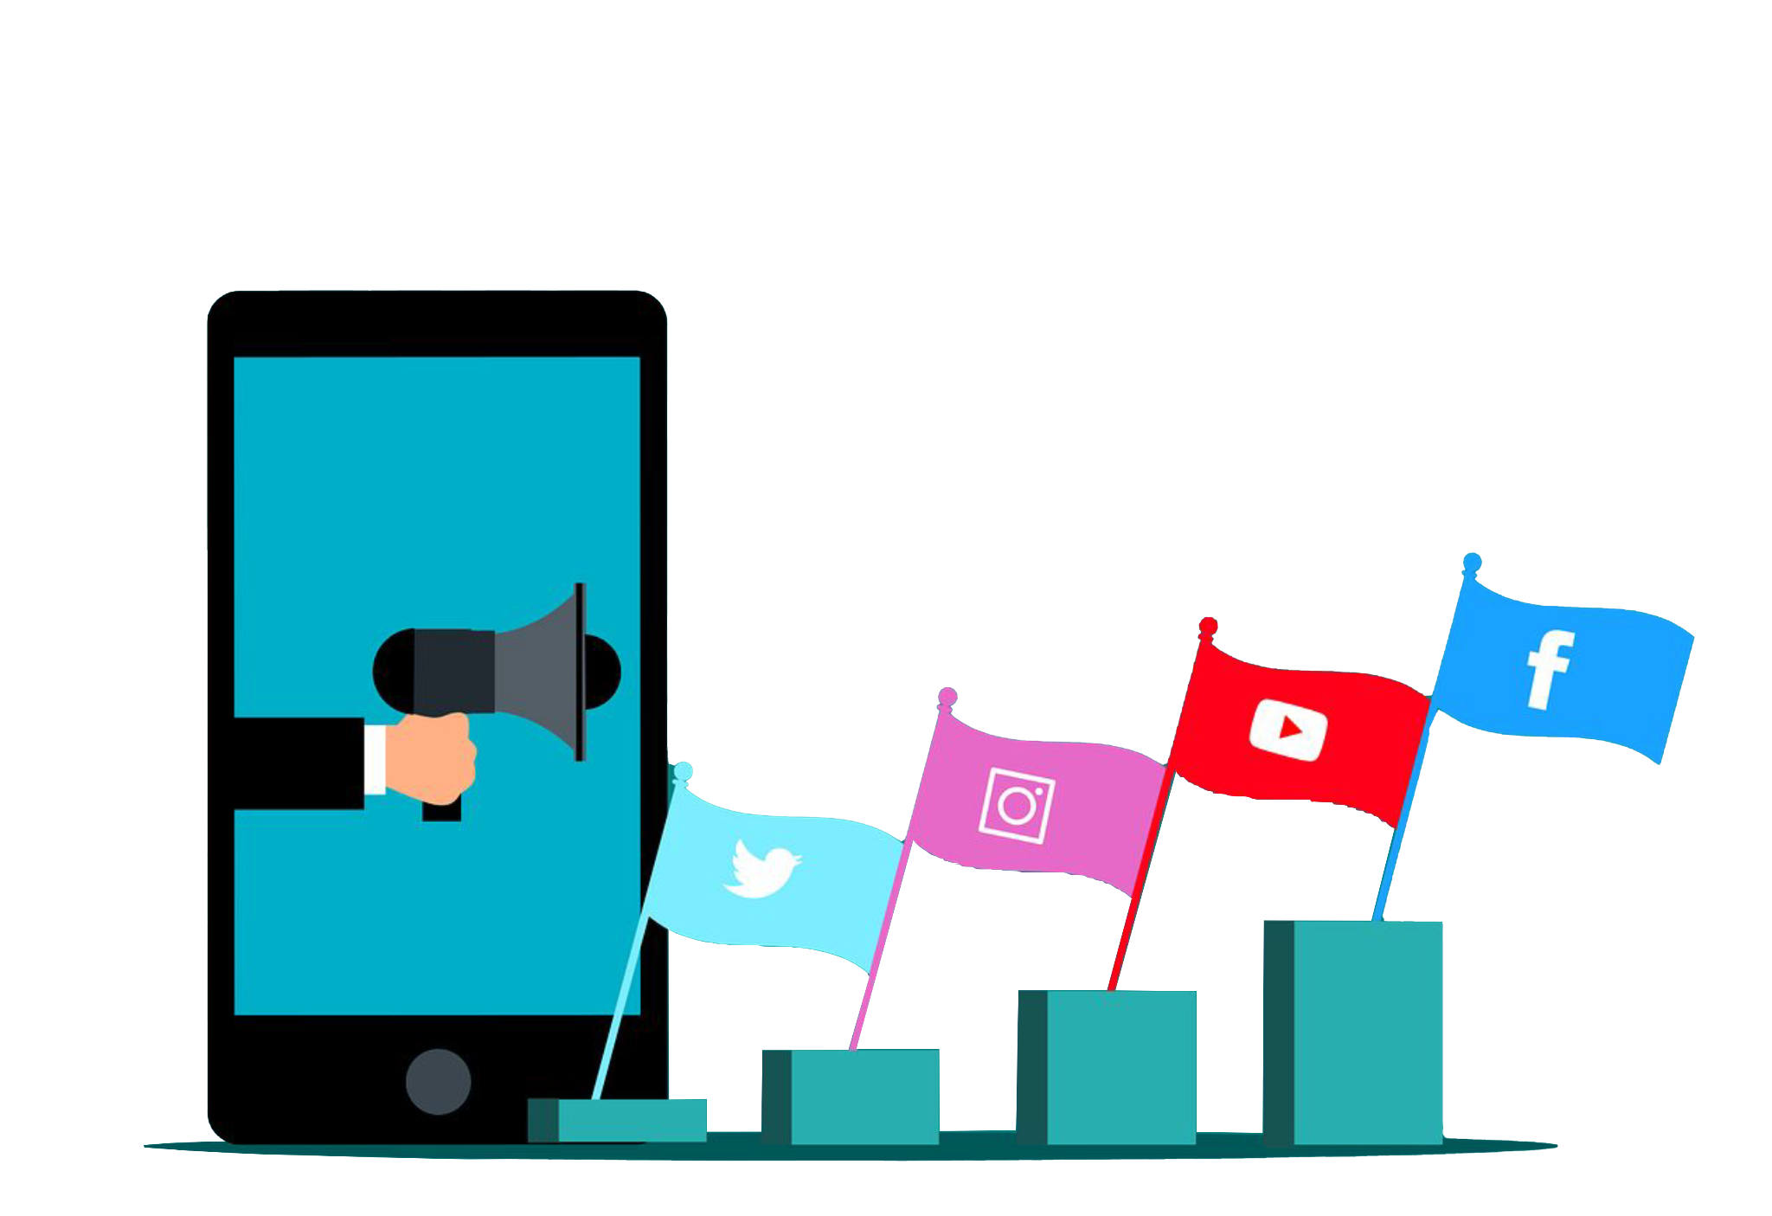
How Do You Create a Social Media Campaign?
Notes:
Social media continues to open spaces for citizens to discuss the issues that they are passionate about. Social media features and networks can help you contact, inform, and mobilize people around an issue—and get them to do something about it.
Although social media is powerful, it is unlikely that you will be able to achieve your policy goal using only social media. Realize that social media is a great tool for policy advocacy, but it is only one tool. You should be deliberate about how you use social media, and consider how it can complement the other tools in your toolbox.

Slide 6
Social Media Campaign Planning
Understand your social media audience and tailor your messages to them
Ensure your messages are evidence-based and data-driven (don’t spread misinformation!)
Include a call to action
Share the right messages on the right platforms
Notes:
When you’re ready to plan out a social media campaign, make sure it aligns with your overall advocacy campaign plan. Coordinating your messages and posts to raise visibility not only for your advocacy issue, but also for supporting events, activities, or products. Here are some things to keep in mind as you plan:
First, tailor your message to your audience. You should be very familiar with this concept by now, but we continue to bring it up because it is of utmost importance. Who is following you on your social media platforms? Who regularly engages with your content? These are the people who will see your messages, so ensure your messages are relevant to them and can be understood by them. Speak their language.
Along the same lines, your messages should be appropriate for the platform. Be aware of character limits! If you have a lot to say, consider using a blog rather than Twitter (but then write a short and snappy Twitter post that links to your blog!). Use photos, videos, links, or whatever you think will make your post stand out and attract attention to your message.
Also, keep in mind that social media is full of untruths and misinformation. Don’t become part of the problem! Anything you post should be evidence-based, meaning you should have data to back up your claims. If you are not sure of the accuracy of your information, do not share it.
Finally, ensure your audience knows what to do in response to your message by including a call to action. “Watch this video,” “share this post,” “sign this petition,” “learn more on this website,” “tweet your representative to tell him…” are all simple actions you can ask your audience to take. These actions should get you closer to achieving the objectives and goal from your advocacy plan.

Slide 7
Review: Components of a Campaign
PROCESS
Plan
Deploy
Track, monitor, adjust if needed
Evaluate, review, reflect
Goal
Objective(s)
Audience
Key message(s)
Strategy, activities, timeline
Notes:
As discussed earlier, your social media plan should fit into your overall advocacy campaign plan. Here is a reminder of what campaign plans should include.
You should select an overall goal and one or more SMART objectives that will help you reach it. You should identify primary and secondary audiences that can push for progress toward your goal, and then develop key messages that will resonate with them. After all that is decided, you should develop some activities to engage your audience and spread your message.
Once you develop your plan, execute it, and make adjustments if your activities aren’t going the way you wanted them to or you aren’t achieving your desired results. When you can, take breaks to evaluate and reflect on what you have accomplished, noting any lessons you have learned that will help you improve your advocacy efforts going forward.

Slide 8
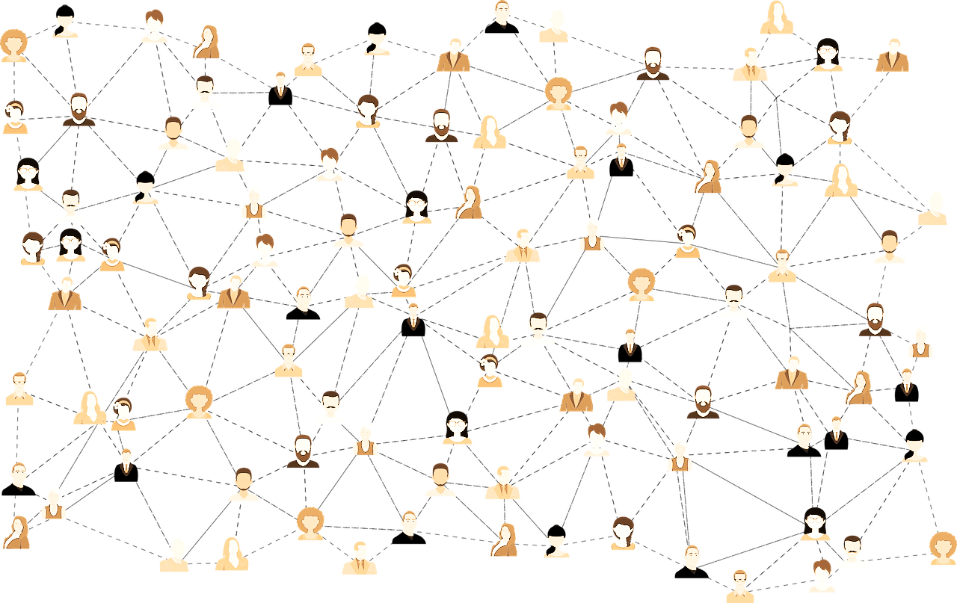
Know Your Social Media Audience
WHO, WHAT, WHEN, HOW?
Who are the specific individuals/groups you need to reach?
What does your audience know about your advocacy issue?
When will your audience be online and interacting with content?
How can you catch their attention?
Notes:
As we have said many times during this training, start by getting to know your audience! Identify who is most likely to support your cause, and go to them wherever they are, using the social media tools and platforms that they use. Your social media audience might be different than your in-person audience. Consider:
What does your audience know about your issue? What misconceptions do they have that you can help correct?
When will your audience be most interactive? You should time your posts to appear when your audience is online and paying attention.
How can you attract your audience’s attention? How likely is it that they will respond to your message? How can you make your posts more appealing to them?
Your answers to these questions will help you frame your posts appropriately.

Slide 9
Social Media Strategy
Which platform(s) will you use?
What will you share and when?
What special moments might you leverage or create?
How much time can you decide to managing your social media? Who will do what?
How will you receive, respond to, and absorb feedback?
Notes:
Once you have analyzed your audience and tailored your messages, you should work on your campaign strategy. Start by evaluating what time and resources are available to you and your team. Be realistic about your ability to engage on any specific platform. Prioritize the social media platforms where your target audience is already present. Choose a central channel for online advocacy efforts, and use additional platforms to point people toward your main channel.
Decide how to introduce your campaign. What messages will you share first? Once your audience is familiar with your issue and campaign, how can you keep their attention and draw them in further?
Many social media platforms allow you to host live events or discussions. Do you want to host a Tweet storm, a Twitter chat, or a conversation on Facebook or Instagram Live? Does your target audience regularly participate in these types of events? If so, they are worth considering. You may also find opportunities to join events that others are hosting, which would allow you to share your perspective with an audience that might not be familiar with your work, expanding your reach. Consider how you might use live-tweeting during in-person events you are hosting, as well.
And, as you probably know, most social media platforms allow people to comment on your posts and share their perspectives. You should decide how to handle negative feedback and when you will and won’t respond to people in your feed.

Slide 10
Measuring Success
Monitor, assess, and report!
Adjust and redeploy if necessary
Use analytic and management tools to measure reach and impact.
Notes:
As your campaign plan is being executed, you should continuously track and monitor it. Is your message believable? Why? Is your campaign successful? Are people talking about your message? Are people engaging with your content? If all is going well, continue; if not, review, adjust, and redeploy.
Many free tools are available to track your social media reach and engagement, and most social media platforms have that functionality built in. Notice which of your posts are getting the most attention. What time were they posted? What was the message? Which multimedia elements were included?

Slide 11
Social Media Best Practices
Be yourself!
Make social media a habit
Think before you post
Build a targeted profile
Have meaningful conversations
Visuals! Visuals! Visuals!
Share anecdotes
Write for anyone
Engage and respond
Look at the data (analytics)
Notes:
As we wrap up, we are going to go over 10 best practices that for social media engagement. These are great ideas to keep in mind as you become a more deliberate user of social media for advocacy and policy communication.
Best practice number 1 is be yourself. You can have a personality on social media! No one wants to be social with a robot. This is why individuals often can garner more followers than organizations, because the connections feel more personal and genuine.
Number 2: Make social media a habit. Checking in twice a day for 10 minutes a day is easier and much more effective than spending an hour at the end of the week trying to figure out everything you missed.
Number 3: Think before you post. You might be able to delete a post, but the internet lives forever, and people often take screenshots. What would your tweet look like on the front page of a major newspaper? Not good? Then don’t post it.
Number 4: Build a targeted profile. If you follow everyone and everything, you are going to be overwhelmed. Decide what your professional goals are for using social media, pursue them, and mix in other interesting content along the way.
Best practice number 5: Have meaningful conversations. Don’t just shout information into the void. Engage with your audience on topics you are passionate about.
Number 6: Bring in visuals, like pictures, graphs, and videos. Visuals perform better on social media than plain text. Remember: Show, don’t tell.
Number 7: Share anecdotes. In addition to being yourself on social media, don’t be afraid to share life anecdotes. The connection feels more personal when you aren’t just an advocate, but also a dog lover, a runner, a sports enthusiast, or whatever else is important to you.
Number 8: Write for anyone. Social media is free! You don’t need a journal subscription or a college degree to use it. Use simple words that anyone can understand. Help your followers to be well informed by giving them quality, data-driven information on critical issues.
Number 9: Engage and respond. Don’t set up a profile and then abandon it or share only your own content—that comes across as worse than not having a profile at all. Remember, social media is about being social! So, make sure to treat people online as you would treat them in person. If someone asked you a question in real life, you wouldn’t just walk away. That being said, it is well within your rights to ignore or block harassment and aggression.
And finally, number 10: Look at the data. One of the best things about Twitter is that you don’t have to have a specific kind of account to see your analytics. Take advantage of this access. You can see which posts do well and which ones don’t, and adjust from there.

Slide 12
Staying Connected With Social Media
Monitor influential leaders’ posts.
Look for opportunities to collaborate.
Attend web events.
Participate in Twitter chats.
Join online communities of practice.
Sign up for email newsletters or updates.
Connect in person.
Notes:
Above all remember—social media is about staying connected. Many of these platforms make it easy to meet like-minded users and draw new connections. You might be surprised just how accessible social media can be for maintaining or strengthening connections.
Consider these strategies to identify and stay connected with influential leaders and your peers:
First, stay abreast of new posts by influential leaders. If they host a website or blog relevant to issues you care about, it’s a good idea to occasionally check out their personal sites for new content.
Next, look out for users with similar interests or posts, and think about how your can collaborate. If you think of a product or event you want to collaborate on, reach out to see if they are interested.
Also, attend online events or webinars related to your topic of interest. These events are great opportunities to access experts and influential leaders. Often you can chat with the host and other participants and ask them questions. Maximize these opportunities by actively participating in the sessions and then following up afterward.
In addition, seek out online communities of practice or networks that that align with your interests or goals, and stay active in them. Often, these groups will post worthwhile updates, discussion topics, and events exclusively to members. You may come across a few influential leaders in these spaces.
Another good strategy is to join the email lists for websites that align with your interests. Sign up for a few that you like. It’s a great way to keep up with news and updates from your field.
Finally, don’t restrict yourself to online connections. When appropriate, take online conversations offline. You might attend an in-person event hosted by an influential leader and make a personal connection that can boost your engagement online, or transform a social media connection into a new opportunity in person and in your work.

Slide 13
Do the Work!
Design a social media campaign strategy that ties into your overall advocacy campaign.
Answer questions on the worksheet to determine your objective, target audience, and call to action, then decide how you will use social media to reach your audience and achieve your objective.
Notes:
Now it is time for our final exercise! [Distribute Exercise 3.5 Worksheet.] Design a social media campaign strategy that fits with your larger advocacy campaign plan. You should start by choosing an objective, a target audience, and an action for them to take. Then you will consider what special moments you might leverage or create, what hashtags or keywords you might use, and finally, you should draft one or two posts for the social media platform you believe would be most appropriate to reach your target audience. After everyone is done, we will come back together as a group and a few of you can share what you came up with.
[Facilitator note: Participants may want to refer to the the worksheet they completed in Exercise 2.3 to remember their overall advocacy objectives and strategy. Allow 10-15 minutes for worksheet completion and another 5-10 minutes for sharing with the rest of the group.]

Slide 14
The End
Notes:
Congratulations on making it through this multimedia advocacy training course! We have talked through all the basic concepts you need to plan and execute an effective policy advocacy campaign. You have analyzed the policy environment and carefully considered where your efforts to influence policy change can fit in. You know how to communicate professionally and to engage with policymakers using data and evidence. You have access to the multimedia tools and social media platforms to expand your reach. Now it is up to you to pull everything together into a cohesive plan, initiate those strategic advocacy actions to create that window of opportunity, and deliver a clear, evidence-based message that will compel your audience to support the change you seek.
We hope you have learned some new skills that will make you a more effective advocate. If you are interested in digging deeper into these concepts, I recommend consulting some of the resources linked at the end of the various slide presentations.
These slides and supplementary materials are available to download for free on PRB’s website (prb.org), so please do so and to share what you’ve learned with others who would benefit.
Now, go forth and make change!

Slide 15
Learn More
Heather Bowen Ray and Michele Schlehofer, “Using Social Media for Digital Advocacy,” University of Kansas.
J. Taylor Scott and J’Vonnah Maryman, “Using Social Media as a Tool to Complement Advocacy Efforts,” Global Journal of Community Psychology Practice 7, no. 1S (2016), 1-22.

